Slide 1
FACILITATOR AGENDA
SECTION | TIME TO COMPLETE | NOTES
COMMUNICATION | Scenario 1: 2-3 minutes Scenario 2: 3-4 minutes Discussion: 10-15 minutes | This section corresponds to the Communication Domain in the Resource Guide. Please pay attention to notes section of each slide for special instructions regarding scenario scripts, discussion and reflection points.
DIGNITY | Scenario 3: 2-3 minutes Scenario 4: 3-4 minutes Discussion: 10-15 minutes | This section corresponds to the Dignity Domain in the Resource Guide. Please pay attention to notes section of each slide for special instructions regarding scenario scripts, discussion and reflection points.
AUTONOMY IN DECISION-MAKING | Scenario 5: 2-3 minutes Scenario 6: 3-4 minutes Discussion: 10-15 minutes | This section corresponds to the Autonomy in Decision-Making Domain in the Resource Guide. Please pay attention to notes section of each slide for special instructions regarding scenario scripts, discussion and reflection points.
Notes:
Note to facilitator: Once your team is assembled, select the respectful maternity care scenario you’d like to begin with. Consult the corresponding section in the Resource Guide for definitions, practices and ideas and then practice a scenario.
The Internal Agenda provides approximate time estimates to help with planning—generally 20–30 minutes per scenario. We’ve suggested 10–15 minutes for discussion, but this can easily be shortened or extended depending on the time you have available. Adjust as needed so the exercise fits within your team’s workflow.

Slide 2
FACILITATOR AGENDA
SECTION | TIME TO COMPLETE | NOTES
INFORMED CONSENT | Scenario 7: 2-3 minutes Scenario 8: 3-4 minutes Discussion: 10-15 minutes | This section corresponds to the Informed Consent Domain in the Resource Guide. Please pay attention to notes section of each slide for special instructions regarding scenario scripts, discussion and reflection points.
RESPECTFUL MATERNITY CARE ACROSS DOMAINS | Scenario 9: 3-4 minutes Scenario 10: 2-3 minutes Discussion: 10-15 minutes | This section includes elements from all domains detailed in the Resource Guide. Please pay attention to notes section of each slide for special instructions regarding scenario scripts, discussion and reflection points.
ACCOUNTABILITY | Scenario 11: 1-2 minutes Scenario 12: 2-3 minutes Discussion: 10-15 minutes | This section corresponds to the Accountability Domain in the Resource Guide. Please pay attention to notes section of each slide for special instructions regarding scenario scripts, discussion and reflection points.
Notes:
Note to facilitator: Once your team is assembled, select the respectful maternity care scenario you’d like to begin with. Consult the corresponding section in the Resource Guide for definitions, practices and ideas and then practice a scenario.
The Internal Agenda provides approximate time estimates to help with planning—generally 20–30 minutes per scenario. We’ve suggested 10–15 minutes for discussion, but this can easily be shortened or extended depending on the time you have available. Adjust as needed so the exercise fits within your team’s workflow.

Slide 3
FUNDING ACKNOWLEDGEMENT
This presentation is supported by the Centers for Disease Control and Prevention (CDC) of the U.S. Department of Health and Human Services (HHS) as part of a financial assistance subaward totaling $450,000 with 100 percent funded by CDC/HHS. The contents are those of the author(s) and do not necessarily represent the views of, nor an endorsement by, CDC/HHS, or the U.S. Government.
Notes:
Facilitator reads this slide with the group. Please pause and discuss if needed.

Slide 4
ACKNOWLEDGEMENT
The National Institute for Children’s Health Quality (NICHQ) developed this resource in March 2026. We acknowledge and appreciate the expertise provided by the NICHQ Respectful Maternity Care Toolkit Workgroup Members.
Notes:
Facilitator reads this slide with the group. Please pause and discuss if needed.

Slide 5
DISCLAIMER
The following clinical scenarios are designed for training and reflection on respectful maternity care practices. While these scenarios may differ from patient encounters you have personally experienced or observed, they are based on real-world situations that do occur in clinical settings. Some examples of disrespectful care may seem obvious, and other behaviors more subtle, but even subtle actions or omissions can significantly impact a patient’s experience, sense of safety and dignity.
We encourage participants to focus on identifying the disrespectful behaviors illustrated in the scenarios and to reflect on how they can actively incorporate the respectful practices demonstrated in the parallel scenarios into their daily clinical care.
Developed March 2026
Notes:
Facilitator reads this slide with the group. Please pause and discuss if needed.

Slide 6
DISCLAIMER
The patient featured in these examples is one specific case, but it is important to recognize that patients of all backgrounds, identities and circumstances, including but not limited to race, ethnicity, language, age, socioeconomic status, immigration status, disability and sexual orientation, may experience disrespectful or inequitable care.
The respectful care practices highlighted here should be applied universally—to every patient, every time.
The most effective way to ensure that all patients are receiving high-quality, respectful maternity care is to routinely assess their experiences through validated patient surveys and/or patient-reported experience measures (PREMs). Listening to and acting on the voices of patients is essential for building equitable, person-centered systems of care.
Developed March 2026
Notes:
Facilitator reads this slide with the group. Please pause and discuss if needed.

Slide 7
INSTRUCTIONS FOR USE
  The slide deck uses animation to guide the order of speech. In addition, body language and non-verbal cues are provided in the facilitator notes.
  Teams may:
    Read through scenarios using the facilitator notes and animated script,
    Engage staff to role-play the scenarios, and/or
    Incorporate the scenarios into simulation training.
  Regardless of the format, prioritize the discussion and reflection portion. We have provided guiding questions, but facilitators are encouraged to add questions tailored to your facility’s context or staff experiences.
Details in these scenarios may not mirror your exact facility setup. As you discuss and reflect, consider how the scenario might look in your own setting and what changes would strengthen respectful care practices there.
Notes:
This instruction slide is primarily for the facilitator. Facilitator may use their discretion as to whether or not to share with your team.

Slide 8



COMMUNICATION

Slide 9
How do we ensure that patients feel heard, informed and included in conversations about their care throughout the maternity journey?
Notes:
Facilitator reads slide.
Facilitator may invite team members to share how they make individuals feel heard, informed, and included in conversations about their care, individually and as a team.

Slide 10


LEARNING OBJECTIVES
OBJECTIVE 1
OBJECTIVE 2
OBJECTIVE 3
OBJECTIVE 4
Distinguish between effective and ineffective verbal and non-verbal communication with maternity patients, especially in multilingual or high-stress contexts.
Demonstrate patient-centered communication approaches that validate emotions, foster trust and encourage shared decision-making.
Use teach-back, open-ended questions and plain language to enhance patient understanding and engagement.
Incorporate professional interpreter services appropriately and consistently, ensuring patients have equitable access to information.
Notes:
Facilitator reads learning objectives.

Slide 11
ADDITIONAL CONTEXT
Insert additional instruction or context for each scenario here.
Notes:
Note to facilitator: Please review each scenario before presenting it to your team. You will find important details to consider in the notes section of the slides such as the description of body language and non-verbal cues. Think about how you want to guide your team through the scenarios.
You may use this optional slide or add any information unique to your facility or team that is important to this training.

Slide 12
COMMUNICATION DOMAIN
Scenario 1: Disrespectful Care

Slide 13


COMMUNICATION: DISRESPECT
Setting:
  Labor and Delivery Triage, early evening
Characters:
  Patient: 29-year-old Black, Spanish-speaking woman named Sherice from the Dominican Republic, visibly in pain, full term, has Medicaid coverage for her health care.
  Support Person: Her cousin, who is also Spanish-speaking and who speaks limited English.
  Triage Nurse: English-speaking, does not speak Spanish.
Notes:
Facilitator reads the scenario setting and description of characters.

Slide 14
COMMUNICATION: DISRESPECT
The patient walks in, holding her belly, breathing heavily with visible discomfort. She is accompanied by her cousin, who speaks limited English and stands close by, looking worried.
Notes:
Facilitator reads slide.

Slide 15



COMMUNICATION: DISRESPECT
You need to tell me your name and what’s wrong. Can you speak English? Hello?
Her name Sherice Rosario. She... much pain.
Sorry, I only speak English—are you here for labor? You can wait over there for a moment.
Por favor...
me duele mucho...
Patient
Support Person
Triage Nurse
Notes:
Note to facilitator: This slide has animation. Advance animation from patient to triage nurse to support person, back to triage nurse to make entire conversation visible.
Patient: “Por favor… me duele mucho...”
(Please, I have a lot of pain)
Nurse (sighs, speaking quickly and loudly): “You need to tell me your name and what’s wrong. Can you speak English? Hello?”
Support person (hesitant English): “Her name Sherice Rosario. She… much pain.”
Nurse (glances up briefly, distracted, with a polite but hurried tone): “Sorry, I only speak English—are you here for labor?” The nurse gestures vaguely toward a row of chairs. “You can wait over there for a moment.”

Slide 16
COMMUNICATION: DISRESPECT
Um, you have...someone...speak Spanish?
I’m not sure, I think you need to fill out this form first. Maybe someone can help later.
Por favor, necesito ayuda...
The nurse passes a clipboard across the counter.
Notes:
Note to facilitator: This slide has animation. Advance animation from patient to support person to triage nurse to make entire conversation visible.
Patient (clutches chair for support, tries again in Spanish): “Por favor, necesito ayuda...”
(Please, I need help...)
Support person (tentatively, in broken English): “Um, you have…someone…speak Spanish?”
Nurse (without meeting their eyes, still typing on the computer): “I’m not sure, I think you need to fill out this form first. Maybe someone can help later.”
The nurse passes a clipboard across the counter.

Slide 17
COMMUNICATION: DISRESPECT
She—she have lot of pain...you help?
We have other patients ahead of you, you can just fill out the form and wait, please.
Notes:
Note to facilitator: This slide has animation. Advance animation from support person to triage nurse to make entire conversation visible.
Support person (softly, trying): “She—she have lot of pain…you help?”
Nurse (with a brief, tight smile): “We have other patients ahead of you, you can just fill out the form and wait, please.”

Slide 18
COMMUNICATION: DISRESPECT
The patient sits in the waiting area, confused and in pain, while her cousin sits beside her, looking concerned. There is no further communication, reassurance or clear plan shared by the staff.
Notes:
Facilitator reads slide.

Slide 19
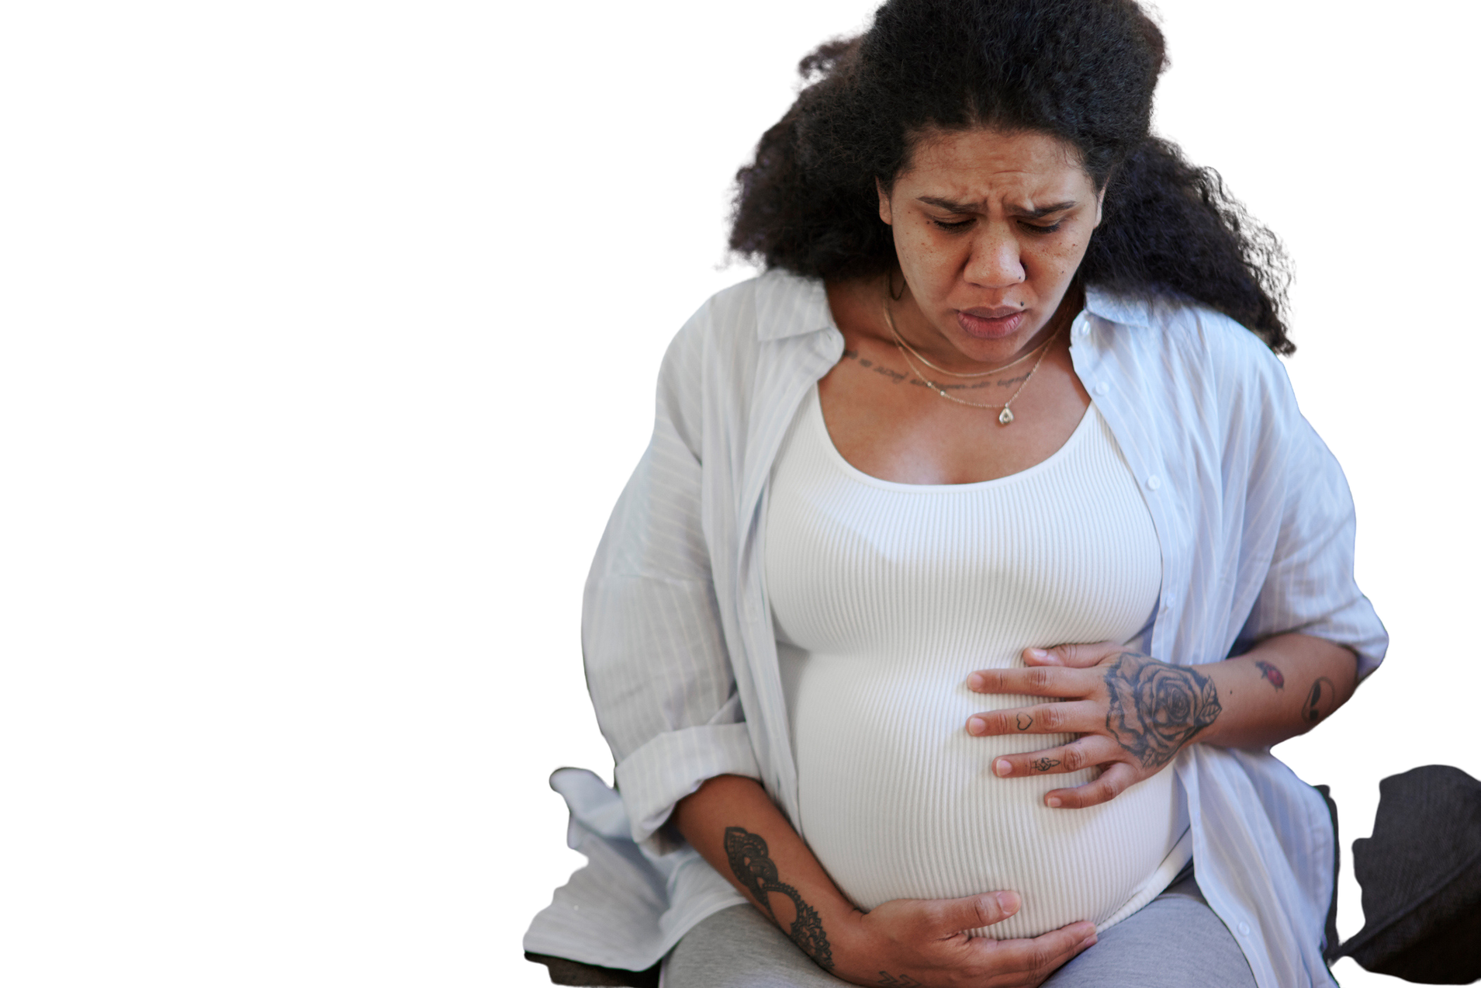

What disrespectful care practices did you observe in this scenario?
Notes:
Facilitator reads slide.
Facilitator may invite team members to share their observations.

Slide 20
DISRESPECTFUL PRACTICES HIGHLIGHTED
No introduction or use of names
Avoids eye contact much of the time
“We’ll see if we can find someone.” (Non-committal, dismissive about interpreter)
Prioritizes typing over engaging
Downplays support person’s request
Ignores visible distress
Uses polite but cold tone, conveying they’re an inconvenience
Dismisses patient’s pain
Notes:
Following reflection, Facilitator reads through disrespectful practices highlighted.

Slide 21
COMMUNICATION DOMAIN
Scenario 2: Respectful Care

Slide 22
COMMUNICATION: RESPECT
Setting:
  Labor and Delivery Triage, early evening
Characters:
  Patient: 29-year-old Black, Spanish-speaking woman named Sherice from the Dominican Republic, visibly in pain, full term.
  Support Person: Her cousin, who is also Spanish-speaking and who speaks limited English.
  Triage Nurse: English-speaking, does not speak Spanish.
  Interpreter: Spanish and English-speaking. Accessed through video.
Notes:
Facilitator reads setting and character description.

Slide 23
COMMUNICATION: RESPECT
The patient walks in, holding her belly, breathing heavily with visible discomfort. She is accompanied by her cousin, who speaks limited English and stands close by, looking worried.
Notes:
Facilitator reads slide.

Slide 24


COMMUNICATION: RESPECT
Hello, my name is Jasmine, and I’m the nurse here. I see you’re having pain. I want to help you.
She no speak English. You have... um... translator?
Por favor...
me duele mucho...
I don’t speak Spanish, but I want to help you. One moment—let me find someone who can translate.
The nurse holds up a hand, then uses the hospital phone to call for interpreter services.
Patient
Support Person
Triage Nurse
Notes:
Note to facilitator: This slide has animation. Advance animation from patient to nurse to support person, back to nurse to make entire conversation visible.
Patient: “Por favor… me duele mucho...”
(Please, I have a lot of pain)
Nurse (calm, gentle tone, with eye contact and a welcoming gesture): “Hello, my name is Jasmine, and I’m the nurse here. I see you’re having pain. I want to help you.”
Support person: She no speak English. You have… um… translator?
Nurse (friendly eye contact, soft voice, gestures to indicate understanding, speaks slowly): “I don’t speak Spanish, but I want to help you. One moment—let me find someone who can translate.”
The nurse holds up a reassuring hand, then uses the hospital phone to call for interpreter services.

Slide 25
COMMUNICATION: RESPECT
Hi, this is OB triage. I need a Spanish interpretation services right away, please. Thank you.
After a short wait, the interpreter is accessed through video.
Notes:
Nurse: Hi, this is OB triage. I need a Spanish interpreter here right away, please. Thank you.
After a short wait, the interpreter arrives (either in-person or via phone/video).

Slide 26

COMMUNICATION: RESPECT
La enfermera quiere ayudarla y va a hacerle algunas preguntas para cuidar de usted y su bebé.
Can you please help translate? I want to make sure she feels safe and understands everything.
Video Interpreter
Notes:
Note to facilitator: This slide has animation. Advance animation from nurse to interpreter to make entire conversation visible.
Nurse (to interpreter): “Can you please help translate? I want to make sure she feels safe and understands everything.”
Interpreter (to patient in Spanish): “La enfermera quiere ayudarla y va a hacerle algunas preguntas para cuidar de usted y su bebé.”
(The nurse wants to help you and will ask some questions to care for you and your baby.)

Slide 27
COMMUNICATION: RESPECT
Can you tell me about the pain—how long, how strong and if you feel the baby moving?
Interpreter translates. Patient responds in Spanish. Nurse listens attentively, nods and reassures patient through interpreter.
Notes:
Note to facilitator: This slide has animation. Advance animation from nurse to interpreter to make entire conversation visible.
Nurse (maintaining eye contact, speaking slowly and calmly): “Can you tell me about the pain—how long, how strong, and if you feel the baby moving?”
Interpreter translates. Patient responds in Spanish. Nurse listens attentively, nods, and reassures patient through interpreter.

Slide 28
COMMUNICATION: RESPECT
You are safe here. We will help you. Let’s get you comfortable and check on your baby right away.
Patient visibly relaxes, feeling heard and respected. Care continues with clear, compassionate communication via interpreter.
Notes:
Nurse (gently): “You are safe here. We will help you. Let’s get you comfortable and check on your baby right away.”
Patient visibly relaxes, feeling heard and respected. Care continues with clear, compassionate communication via interpreter.

Slide 29
What respectful care practices did you observe in this scenario?
Notes:
Facilitator reads slide.
Facilitator may invite team members to share their observations.

Slide 30
RESPECTFUL PRACTICES HIGHLIGHTED
Introduced self with name and role
Used calm, reassuring tone
Made eye contact and acknowledged the patient as a person
Immediately responded to the request for an interpreter
Used gestures to bridge the gap while waiting for interpretation
Validated distress and communicated safety
Included the support person appropriately
Notes:
Following reflection, Facilitator reads respectful practices highlighted.

Slide 31
FURTHER REFLECTION AND DISCUSSION
  How do you know a patient truly understands what you’re saying? What strategies do you use to assess comprehension?
  Think of a time when a communication breakdown happened on your unit. What contributed to it, and how was it resolved?
  What are some ways we can improve language access and use of interpreter services in fast-paced clinical settings?
  How can we create space for open, honest dialogue with patients who feel nervous, overwhelmed or unheard?
  What kinds of situations have you experienced that relate to this domain/scenario?
  What systems/procedures/policies are needed to support respectful care in your clinical setting?
Notes:
Note to facilitator: This is the last slide in the Communication section. Here are some ideas to assist with further reflection and discussion on this scenario with your group. For additional ideas, please review the Communication Domain in the Resource Guide.

Slide 32
NEXT STEPS
Next steps content
Notes:
Note to facilitator: This is an optional slide for you to identify next steps for your team.

Slide 33
DIGNITY

Slide 34
How do we ensure that a maternity patient feels seen, heard, safe and valued in their care, especially during vulnerable moments?
Notes:
Facilitator reads slide.
Facilitator may invite team members to share how they make individuals feel seen, heard, safe, and valued in their care, individually and as a team.

Slide 35



LEARNING OBJECTIVES
OBJECTIVE 1
OBJECTIVE 2
OBJECTIVE 3
OBJECTIVE 4
Identify behaviors and language that can affirm patient dignity during maternity care.
Describe the impact of maintaining privacy, respectful tone and acknowledging patient identity on maternal health experiences and outcomes.
Practice responding to patient emotions and fears in ways that promote compassion and humanize care.
Demonstrate strategies to preserve patient dignity even during high-stress or emergency clinical situations.
Notes:
Facilitator reads learning objectives.

Slide 36
ADDITIONAL CONTEXT
Insert additional facilitator context for each scenario here.
Notes:
Note to facilitator: Please review each scenario before presenting it to your team. You will find important details to consider in the notes section of the slides such as the description of body language and non-verbal cues. Think about how you want to guide your team through the scenarios.
You may use this optional slide or add any information unique to your facility or team that is important to this training.

Slide 37
DIGNITY DOMAIN
Scenario 3: Disrespectful Care

Slide 38
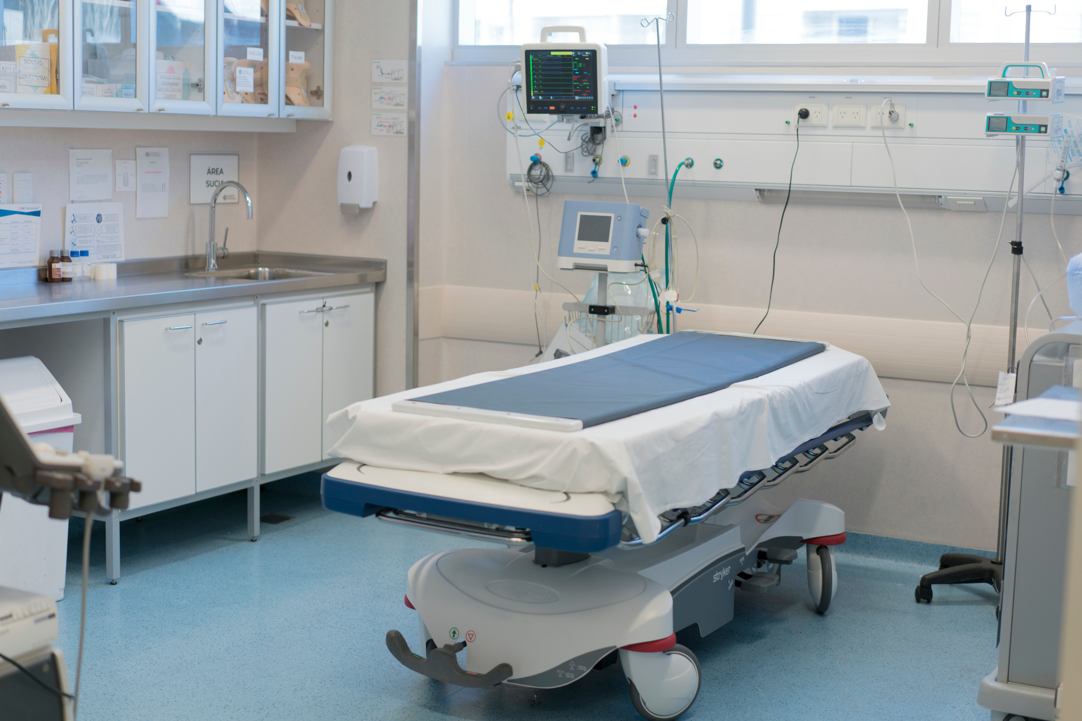

DIGNITY: DISRESPECT
Setting:
  Same triage room. Sherice is lying on the bed in pain. The nurse has already asked some questions with the interpreter. The provider arrives.
Characters:
  Patient: 29-year-old Black, Spanish-speaking woman named Sherice from the Dominican Republic, has Medicaid coverage for her health care.
  Support Person: Her cousin, who is also Spanish-speaking and who speaks limited English.
  Obstetrician: English-speaking, does not speak Spanish.
  Interpreter: Spanish and English-speaking. Accessed through video.
Notes:
Facilitator reads the scenario setting and description of characters.

Slide 39

DIGNITY: DISRESPECT
Okay. Let’s see what’s going on.
Video Interpreter
Physician
Patient
Interpreter interprets the entire conversation with the obstetrician in Spanish.
Support Person
Notes:
Note to facilitator: This slide has animation. Advance animation from provider to interpreter to make entire conversation visible.
Provider (walks in briskly, no eye contact): Okay. Let’s see what’s going on.
Interpreter (interprets the entire conversation with the provider in Spanish)

Slide 40
DIGNITY: DISRESPECT
I’m going to check you now.
She… want privacy…
¿Aquí? Hay gente…
Ok, sorry about that.
The obstetrician closes the curtain while starting to reach and lift the patient’s gown for the exam.
Notes:
Note to facilitator: This slide has animation. Advance animation from provider to patient to support person to provider to make entire conversation visible.
Provider (snapping gloves on, speaking quickly): I’m going to check you now.
Patient (anxious): ¿Aquí? Hay gente…
(Here? There are people…)
Support person (Cousin): She… want privacy…
Provider (glancing around, dismissive): Ok, sorry about that (closes curtain, while starting to reach and lift patient’s gown for the exam)

Slide 41
DIGNITY: DISRESPECT
This exam should not hurt if you just let your legs flop apart and relax.
The obstetrician proceeds to start the exam.
Notes:
Provider: This exam should not hurt if you just let your legs flop apart and relax (proceeds to start exam).

Slide 42
DIGNITY: DISRESPECT
Por favor…
Relax. If you don’t relax the exam will be uncomfortable and I won’t be able to tell how far along you are.
The patient is visibly tense, squeezing her cousin’s hand.
Notes:
Note to facilitator: This slide has animation. Advance animation from patient to provider, back to patient to make entire conversation visible.
Patient (uncomfortable, tears in eyes): Por favor…
Provider: Relax. If you don’t relax the exam will be uncomfortable and I won’t be able to tell how far along you are.
Patient (visibly tense, squeezing her cousin’s hand)

Slide 43
DIGNITY: DISRESPECT
You’re barely dilated. You aren’t in real labor yet. Just wait and we will check you again in a bit.
The patient is lying there, exposed, crying softly.
Notes:
Provider (finishes quickly, stands to leave): You’re barely dilated. You aren’t in real labor yet. Just wait and we will check you again in a bit.
Patient: Lying there, exposed, crying softly.

Slide 44

What disrespectful care practices did you observe in this scenario?
Notes:
Facilitator reads slide.
Facilitator may invite team members to share their observations.

Slide 45
DISRESPECTFUL PRACTICES HIGHLIGHTED
No introduction or use of her name
No explanation before touching
Dismisses request for privacy
No draping or effort to cover her
No empathy or emotional support
Rushes and is rough
Talks about her loudly in front of others
Notes:
Following reflection, Facilitator reads through disrespectful practices highlighted.

Slide 46
DIGNITY DOMAIN
Scenario 4: Respectful Care

Slide 47
DIGNITY: RESPECT
Setting:
  Same triage room. Provider arrives after nurse has completed intake with interpreter.
Characters:
  Patient: 29-year-old Black, Spanish-speaking woman named Sherice from the Dominican Republic, has Medicaid coverage for her health care.
  Support Person: Her cousin, who is also Spanish-speaking and who speaks limited English.
  Obstetrician: English-speaking, does not speak Spanish.
  Interpreter: Spanish and English-speaking. Accessed through video.
Notes:
Facilitator reads setting and character description.

Slide 48

DIGNITY: RESPECT
Hi. May I come in?
Sí…
Hello, Sherice. My name is Dr. López. I’m here to take care of you.
Gracias…
Video Interpreter
Patient
Interpreter interprets the entire conversation with the obstetrician in Spanish.
Support Person
Physician
Notes:
Note to facilitator: This slide has animation. Advance animation from provider to interpreter, back to provider to make entire conversation visible.
Provider (knocks gently before entering): Hi. May I come in?
Interpreter (interprets the entire conversation with the provider in Spanish):
Patient (weakly): Sí…
Provider (comes in slowly, eye contact): Hello, Sherice. My name is Dr. López. I’m here to take care of you. [Sits at her level]
Patient: Gracias…

Slide 49
DIGNITY: RESPECT
I know you’re in pain. I want to make sure you and your baby are okay.
Está bien…
Notes:
Note to facilitator: This slide has animation. Advance animation from provider to patient to make entire conversation visible.
Provider (warm tone): I know you’re in pain. I want to make sure you and your baby are okay.
Patient (tearful): Está bien…
(it’s fine…)

Slide 50
DIGNITY: RESPECT
Thank you both for being here. Sherice, would you like your cousin to stay during the exam, or wait outside?
Quiero que se quede…
Of course. Your choice. She can stay.
Notes:
Note to facilitator: This slide has animation. Advance animation from provider to patient, back to provider to make entire conversation visible.
Provider (looks at both patient and support person): Thank you both for being here. Sherice, would you like your cousin to stay during the exam, or wait outside?
Patient: Quiero que se quede…
(I want her to stay…)
Provider (nodding): Of course. Your choice. She can stay.

Slide 51
DIGNITY: RESPECT
Before we start, can you tell me what worries you most right now?
El bebé… quiero saber si está bien…
Notes:
Note to facilitator: This slide has animation. Advance animation from provider to patient to make entire conversation visible.
Provider (calm, respectful): Before we start, can you tell me what worries you most right now?
Patient: El bebé… quiero saber si está bien…
(The baby… I want to know if he’s okay…)

Slide 52
DIGNITY: RESPECT
That is very important. Everything looks good right now on the monitor. We will continue to check your baby to make sure all is well. I also need to examine you to see if you are in labor. We’ll do this as privately as we can.
The obstetrician looks around and closes the curtain fully.
Notes:
Provider (softly):
That is very important. Everything looks good right now on the monitor. We will continue to check your baby to make sure all is well. I also need to examine you to see if you are in labor. We’ll do this as privately as we can. [Looks around, closes curtain fully]

Slide 53
DIGNITY: RESPECT
Let’s make sure you’re covered.
The obstetrician uses a sheet to drape her carefully.
Notes:
Provider: Let’s make sure you’re covered. [Uses sheet to drape her carefully].

Slide 54
DIGNITY: RESPECT
Is it ok if I examine you now?
Sí…
I’ll tell you each step before I do anything. If you want me to stop at any time, just say so.
Está bien… gracias…
Are you ready for me to begin?
Sí.
Notes:
Note to facilitator: This slide has animation. Advance animation from provider to patient make entire conversation visible.
Provider: Is it ok if I examine you now?
Patient (nods) :Sí
(yes)
Provider (calm voice): I’ll tell you each step before I do anything. If you want me to stop at any time, just say so.
Patient (nods) : Está bien… gracias…
(it’s fine… thanks…)
Provider (makes gentle eye contact): Are you ready for me to begin?
Patient: Sí.
(yes)

Slide 55
DIGNITY: RESPECT
You’re doing well. Thank you for letting me check. I’m being very gentle. All done. You are about one centimeter dilated, in early labor.
The obstetrician completes the exam.
Notes:
Provider (during exam, calm tone): You’re doing well. Thank you for letting me check. I’m being very gentle.
Provider completes the exam.
Provider: All done. You are about one centimeter dilated, in early labor.

Slide 56
DIGNITY: RESPECT
We’ll talk now about your options for comfort and next steps. Do you have any questions for me?
De nada. Estamos aquí para usted.
You’re welcome. We’re here for you.
No… gracias, doctor…
Notes:
Note to facilitator: This slide has animation. Advance animation from provider to patient, back to provider and to interpreter to make entire conversation visible.
Provider (warm smile): We’ll talk now about your options for comfort and next steps. Do you have any questions for me?
Patient (visibly calmer): No… gracias, doctor…
(No… Thank you, Doctor..)
Provider: You’re welcome. We’re here for you.
Interpreter:
De nada. Estamos aquí para usted.
(you’re welcome. We’re here for you).

Slide 57
What respectful care practices did you observe in this scenario?
Notes:
Facilitator reads slide.
Facilitator may invite team members to share their observations.

Slide 58
RESPECTFUL PRACTICES HIGHLIGHTED
Knocked before entering
Introduced self by name and role
Sat at eye level, made eye contact
Used preferred language (through interpreter)
Asked about support person’s presence—honored choice
Closed curtain for privacy
Notes:
Following reflection, Facilitator reads respectful practices highlighted.

Slide 59
RESPECTFUL PRACTICES HIGHLIGHTED
Draped patient to protect modesty
Explained exam steps in plain language
Asked permission before doing exam
Checked in during exam, reassured the patient, used gentle tone
Communicated results of the exam and offered time for questions
Addressed emotional worries
Notes:
Following reflection, Facilitator reads respectful practices highlighted.

Slide 60
FURTHER REFLECTION AND DISCUSSION
  Can you recall a time when you or your team preserved a patient's dignity in a high-stress situation? What did that look like?
  What types of language, tone or body language might unintentionally strip a patient of dignity during labor or birth?
  How do institutional policies or environments (e.g., overcrowding, time constraints, lack of privacy) make it harder to uphold dignity—and how can we navigate those constraints?
  How do race, language, religion, socioeconomic status or prior trauma influence a person’s perception of dignity in health care? (e.g., what feels dignified can vary based on cultural and personal values.)
Notes:
Note to facilitator: This is the last slide in the Dignity section. Here are some ideas to assist with further reflection and discussion on this scenario with your group. For additional ideas, please review the Dignity Domain in the Resource Guide.

Slide 61
NEXT STEPS
Next steps content
Notes:
Note to facilitator: This is an optional slide for you to identify next steps for your team.

Slide 62
AUTONOMY IN DECISION-MAKING

Slide 63
How do we empower patients to make informed decisions about their care, free from pressure or judgement?
Notes:
Facilitator reads slide.
Facilitator may invite team members to share how they empower patients to make informed decisions about their care, individually and as a team.

Slide 64



LEARNING OBJECTIVES
OBJECTIVE 1
OBJECTIVE 2
OBJECTIVE 3
OBJECTIVE 4
Define patient autonomy in the context of childbirth and explain how clinical teams can support or hinder it.
Demonstrate how to engage patients in collaborative care planning that respects their values, preferences and lived experiences.
Identify subtle forms of coercion or paternalism that can undermine patient autonomy.
Practice offering care options with a neutral tone, allowing space for patient consideration and choice, even in urgent clinical situations.
Notes:
Facilitator reads learning objectives.

Slide 65
ADDITIONAL CONTEXT
Insert additional instruction or context for each scenario here.
Notes:
Note to facilitator: Please review each scenario before presenting it to your team. You will find important details to consider in the notes section of the slides such as the description of body language and non-verbal cues. Think about how you want to guide your team through the scenarios.
You may use this optional slide or add any information unique to your facility or team that is important to this training.

Slide 66
AUTONOMY IN DECISION-MAKING DOMAIN
Scenario 5: Disrespectful Care

Slide 67
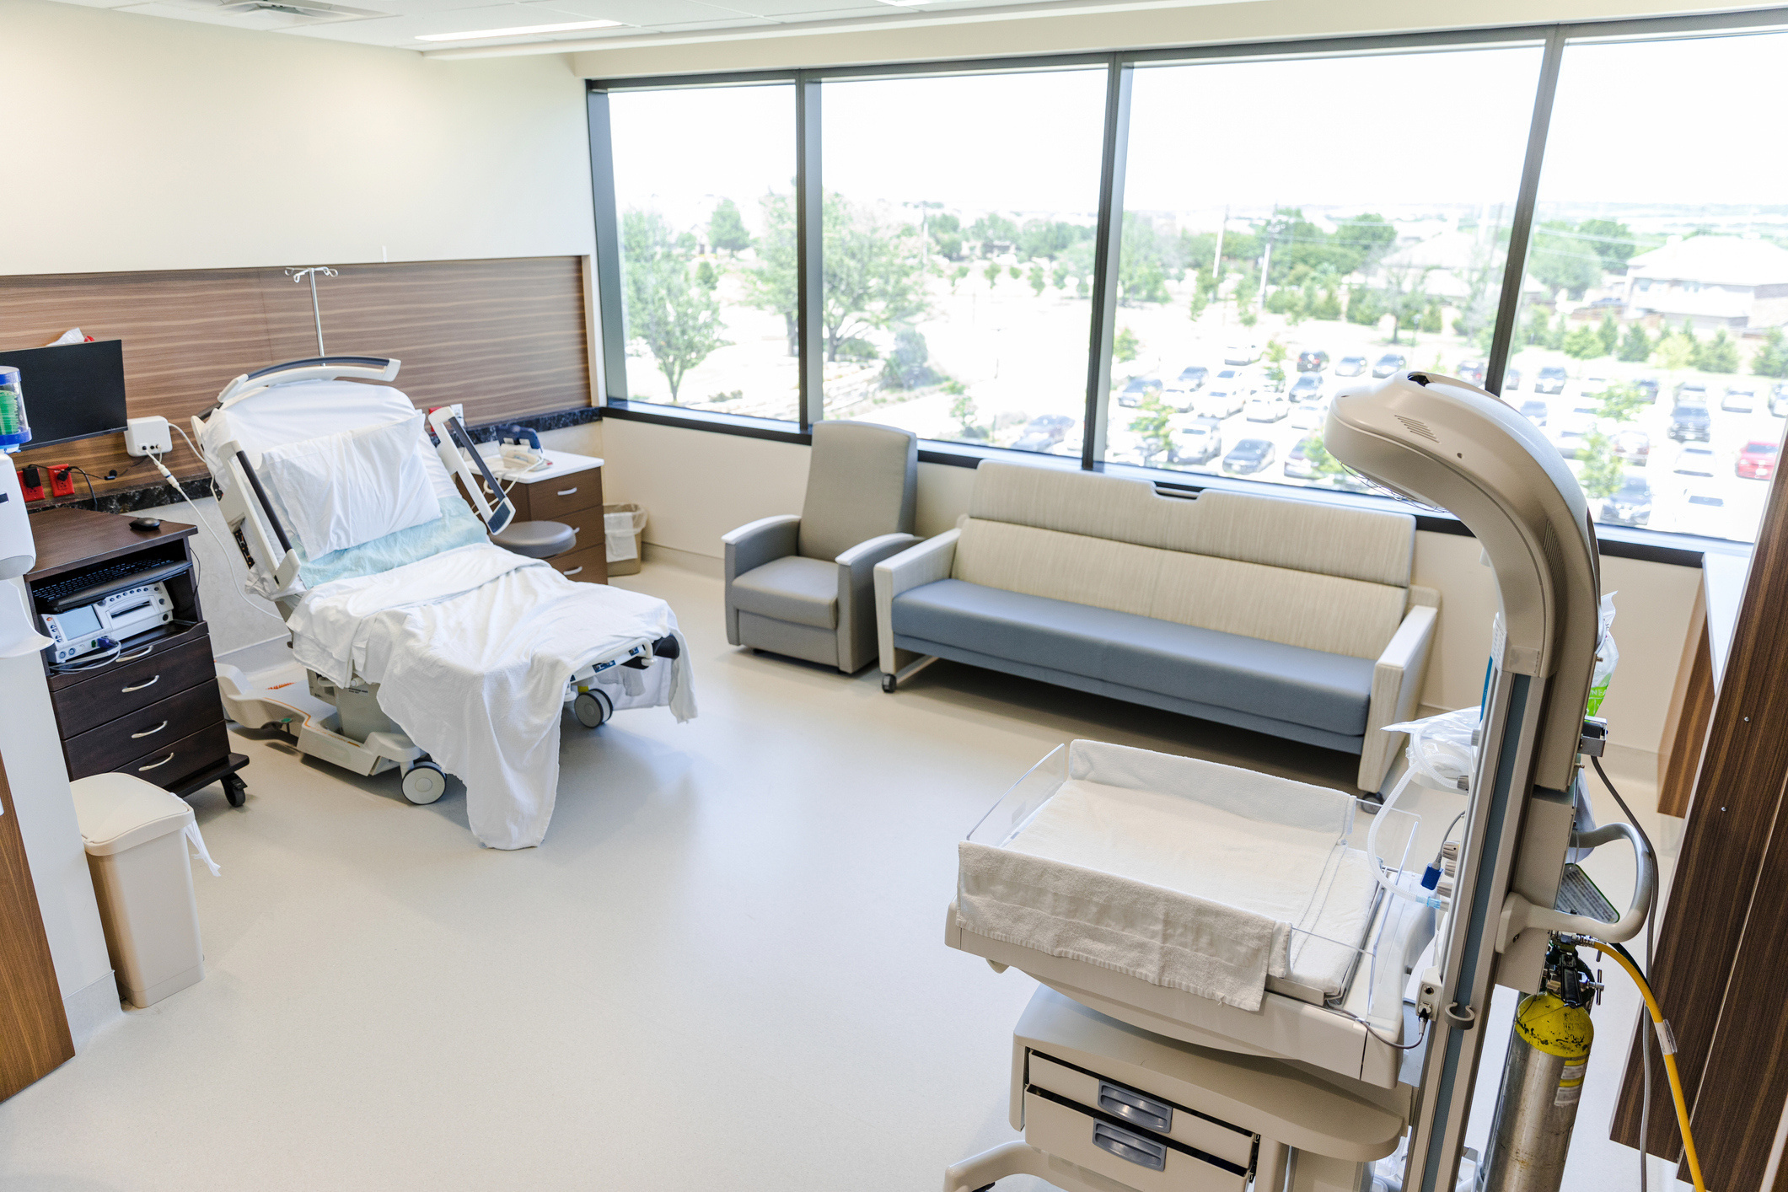

AUTONOMY: DISRESPECT
Setting:
  The patient has been admitted in active labor and is in bed in her labor and delivery room, visibly uncomfortable but alert. A continuous electronic fetal monitor (EFM) is strapped to her belly. The nurse enters and begins speaking to the support person instead of the patient.
Characters:
  Patient: 29-year-old Black, Spanish-speaking woman named Sherice from the Dominican Republic, has Medicaid coverage for her health care.
  Support Person: Her cousin, who is also Spanish-speaking and who speaks limited English.
  Obstetrician: English-speaking, does not speak Spanish.
  Nurse: English-speaking, does not speak Spanish.
Notes:
Facilitator reads the scenario setting and description of characters.

Slide 68

AUTONOMY: DISRESPECT
She say... not want this always. It hurt... she want walk.
I know it’s not comfortable, but this is hospital policy. She had a C-section before—she has to stay on the monitor.
No quiero esto todo el tiempo. Me molesta. ¿Puedo caminar?
Can... maybe other way? Sometimes on, sometimes off?
No, not really. This is just how we do it. The doctor will say the same.
Patient
Support Person
Nurse
Notes:
Note to facilitator: This slide has animation. Advance animation from patient to support person to nurse to make entire conversation visible.
Patient (in Spanish):
(To support person) “No quiero esto todo el tiempo. Me molesta. ¿Puedo caminar?”
(I don't want this all the time. It bothers me. Can I walk?)
Support Person (to nurse):
“She say... not want this always (pointing to the EFM strap). It hurt... she want walk.”
Nurse (without making eye contact, distractedly adjusting monitor):
“I know it’s not comfortable, but this is hospital policy. She had a C-section before—she has to stay on the monitor.”
Support Person:
“Can... maybe other way? Sometimes on, sometimes off?”
Nurse (sighs):
“No, not really. This is just how we do it. The doctor will say the same.”

Slide 69
AUTONOMY: DISRESPECT
She keeps asking to take the monitor off. I told her we’ll just have to keep her on since she’s a trial of labor after cesarean. I didn’t get the interpreter again—it’s hard to get them quickly.
Obstetrician
Notes:
Provider enters briefly, standing at a distance.
Nurse (to provider):
“She keeps asking to take the monitor off. I told her we’ll just have to keep her on since she’s a trial of labor after cesarean. I didn’t get the interpreter again—it’s hard to get them quickly.”

Slide 70
AUTONOMY: DISRESPECT
Hi—I understand there’s a question about the monitor? Because of her past C-section, we need to monitor continuously. It’s not really something we can talk about—it’s hospital policy.
She feel not good… wants walk.
I understand, but we have to monitor for safety. Let us know if there’s anything else.
Notes:
Note to facilitator: This slide has animation. Advance animation from physician to support person, back to provider to make entire conversation visible.
Provider to Support Person: “Hi—I understand there’s a question about the monitor? Because of her past C-section, we need to monitor continuously. It’s not really something we can talk about—it’s hospital policy.”
Support Person: “She feel not good… wants walk.”
Provider: “I understand, but we have to monitor for safety. Let us know if there’s anything else.”

Slide 71
AUTONOMY: DISRESPECT
The obstetrician leaves. The nurse tightens the monitor belt and turns back to the screen. The patient looks anxious and feels unheard.
Notes:
Facilitator reads slide.

Slide 72

What disrespectful care practices did you observe in this scenario?
Notes:
Facilitator reads slide.
Facilitator may invite team members to share their observations.

Slide 73
DISRESPECTFUL PRACTICES HIGHLIGHTED
Dismissed patient’s expressed discomfort and desire for mobility
Relied on “hospital policy” to shut down conversation, without explanation or alternatives
Did not attempt communication in the patient’s language
Failed to assess reasons for refusal or concern
Gave no space or support for shared decision-making
Treated patient as a clinical case, not an individual
Notes:
Following reflection, Facilitator reads through disrespectful practices highlighted.

Slide 74
AUTONOMY IN DECISION-MAKING DOMAIN
Scenario 6: Respectful Care

Slide 75
AUTONOMY: RESPECT
Setting:
  Labor and delivery room, same situation. The nurse has accessed an interpreter on video. The full conversation is interpreted in Spanish. The patient is visibly uncomfortable with the monitor and asks if it’s possible to take it off sometimes.
Characters:
  Patient: 29-year-old Black, Spanish-speaking woman named Sherice from the Dominican Republic, has Medicaid coverage for her health care.
  Support Person: Her cousin, who is also Spanish-speaking and who speaks limited English.
  Obstetrician: English-speaking, does not speak Spanish.
  Nurse: English-speaking, does not speak Spanish.
  Interpreter: Spanish- and English-speaking. Accessed through video.
Notes:
Facilitator reads setting and character description.

Slide 76

AUTONOMY: RESPECT
We have the interpreter on video so we can all understand each other clearly—your voice matters. Can you tell me what’s most important to you right now?
I don’t like the monitor on all the time. I want to move more. It’s very uncomfortable.
Thank you for sharing that. You deserve to feel safe and heard. Let’s talk more about this. I’ll ask the obstetrician to come in so we can all discuss it together.
Video Interpreter
Patient
Support Person
Nurse
Notes:
Note to facilitator: This slide has animation. Advance animation from nurse to patient, back to nurse to make entire conversation visible.
Nurse (sitting beside the patient, with video interpreter):
“We have the interpreter on video so we can all understand each other clearly—your voice matters. Can you tell me what’s most important to you right now?”
Patient (via interpreter):
“I don’t like the monitor on all the time. I want to move more. It’s very uncomfortable.”
Nurse (calm tone, maintaining eye contact):
“Thank you for sharing that. You deserve to feel safe and heard. Let’s talk more about this. I’ll ask the provider to come in so we can all discuss it together.”

Slide 77
AUTONOMY: RESPECT
Hola, I want to thank you for sharing your concerns. I understand you’re wondering about taking the monitor off sometimes. I’d like to explain why we’re recommending continuous monitoring.
Patient listens attentively.
Physician
Notes:
The provider enters, greets the patient and support person warmly, and sits at bedside.
Provider(via interpreter):
“Hola, I want to thank you for sharing your concerns. I understand you’re wondering about taking the monitor off sometimes. I’d like to explain why we’re recommending continuous monitoring.”
Patient listens attentively.

Slide 78
AUTONOMY: RESPECT
Because you’ve had a cesarean birth before and are laboring for a vaginal birth now, we want to watch the baby’s heart rate closely the entire time. This helps us catch any early signs of stress.
Our hospital requires continuous monitoring for patients with a prior C-section because it’s the safest way we know to reduce risks for you and your baby. I know that might not be what you hoped, but we are committed to working with you to make it as comfortable as possible.
Patient nods slowly but still looks concerned.
Notes:
Provider (via interpreter):
“Because you’ve had a cesarean birth before and are laboring for a vaginal birth now, we want to watch the baby’s heart rate closely the entire time. This helps us catch any early signs of stress.”
“Our hospital requires continuous monitoring for patients with a prior C-section because it’s the safest way we know to reduce risks for you and your baby. I know that might not be what you hoped, but we are committed to working with you to make it as comfortable as possible.”
Patient nods slowly but still looks concerned.

Slide 79
AUTONOMY: RESPECT
Is there something specific that’s worrying you about this? I want to be sure you’re completely comfortable with what’s happening.
I want to move around. It hurts to lie still.
That makes sense. Thank you for telling us. There are still some options we can try—wireless monitors or different positions that allow you some movement. Would you like us to show you?
Yes, I’d like that.
Notes:
Note to facilitator: This slide has animation. Advance animation from provider to patient to make entire conversation visible.
Provider (soft tone, via interpreter):
“Is there something specific that’s worrying you about this? I want to be sure you’re completely comfortable with what’s happening.”
Patient (via interpreter): “I want to move around. It hurts to lie still.”
Provider:
“That makes sense. Thank you for telling us. There are still some options we can try—wireless monitors or different positions that allow you some movement. Would you like us to show you?”
Patient (via interpreter): “Yes, I’d like that.”

Slide 80
AUTONOMY: RESPECT
Let’s work together on a plan. If at any time you feel uncomfortable or have more questions, please tell us. We’re here for you.
Notes:
Nurse:
“Let’s work together on a plan. If at any time you feel uncomfortable or have more questions, please tell us. We’re here for you.”

Slide 81
What respectful care practices did you observe in this scenario?
Notes:
Facilitator reads slide.
Facilitator may invite team members to share their observations.

Slide 82
RESPECTFUL PRACTICES HIGHLIGHTED
Used interpreter to ensure clear communication in patient’s preferred language
Sat at bedside and used calm tone, open-ended questions and affirmed the patient’s voice
Clearly explained the clinical rationale and hospital policy without shutting down conversation
Explicitly affirmed the patient’s right to ask questions and express preferences
Offered alternatives within constraints (e.g., wireless monitoring, positional changes)
Supported patient’s autonomy and treated her as an individual, not just a clinical protocol
Notes:
Following reflection, Facilitator reads respectful practices highlighted.

Slide 83
FURTHER REFLECTION AND DISCUSSION
  What does autonomy look like in labor and delivery? What are the signs that it’s being supported? What are the signs that it’s being undermined?
  How do we balance medical urgency with the need to respect a patient’s preferences in decision making?
  How do you respond to patients who have a birth plan? Do you ignore it or try to consider the patient’s wishes as part of the care plan?
  How can we handle situations where a patient declines a recommended intervention? What language or approach shows respect?
  Can you think of a time when a patient’s decision was different from what was recommended, but you considered it and/or supported it anyway? What did that require of you?
Notes:
Note to facilitator: This is the last slide in the Autonomy in Decision-Making section. Here are some ideas to assist with further reflection and discussion on this scenario with your group. For additional ideas, please review the Autonomy in Decision-Making Domain in the Resource Guide.

Slide 84
NEXT STEPS
Next steps content
Notes:
Note to facilitator: This is an optional slide for you to identify next steps for your team.

Slide 85
INFORMED CONSENT

Slide 86
How do we ensure clear, culturally-responsive communication to the patient about maternity physical exams, procedures, tests and interventions?
Notes:
Facilitator reads slide.
Facilitator may invite team members to share how they ensure clear, culturally-responsive communication to the patient about their care, individually and as a team.

Slide 87



LEARNING OBJECTIVES
OBJECTIVE 1
OBJECTIVE 2
OBJECTIVE 3
OBJECTIVE 4
Explain the principles of informed consent as an ongoing, interactive process, not a one-time signature.
Demonstrate how to provide clear, culturally appropriate explanations of risks, benefits and alternatives for maternity interventions.
Identify common barriers to true informed consent (e.g., time pressure, language access, fear) and strategies to address them.
Practice reaffirming consent at key decision points, using language that checks patient understanding of and comfort with the plan.
Notes:
Facilitator reads learning objectives.

Slide 88
ADDITIONAL CONTEXT
Insert additional instruction or context for each scenario here.
Notes:
Note to facilitator: Please review each scenario before presenting it to your team. You will find important details to consider in the notes section of the slides such as the description of body language and non-verbal cues. Think about how you want to guide your team through the scenarios.
You may use this optional slide or add any information unique to your facility or team that is important to this training.

Slide 89
INFORMED CONSENT
DOMAIN
Scenario 7: Disrespectful Care

Slide 90
INFORMED CONSENT: DISRESPECT
Setting:
  Labor and Delivery Room, patient in active labor with increasing pain, with contractions every three minutes. She appears increasingly uncomfortable. A nurse enters with the anesthesiologist and a Spanish interpreter connected by video.
Characters:
  Patient: 29-year-old Black, Spanish-speaking woman named Sherice from the Dominican Republic, has Medicaid coverage for her health care.
  Nurse: English-speaking, does not speak Spanish.
  Anesthesiologist: English-speaking, does not speak Spanish.
  Interpreter: Spanish and English-speaking. Accessed through video.
Notes:
Facilitator reads the scenario setting and description of characters.

Slide 91

INFORMED CONSENT: DISRESPECT
Anesthesia is here now. It looks like you’re in a lot of pain, and since you said you wanted to get an epidural and your labor is advancing quickly, we’re going to do your epidural now.
¿Es necesario? ¿Está bien el bebé?
Yes, everything is fine. It’s better to get it now before it’s too late.
Video Interpreter
Patient
Nurse
Anesthesiologist
Notes:
Note to facilitator: This slide has animation. Advance animation from nurse to patient to nurse to make entire conversation visible.
Nurse (hurriedly, through interpreter): “Anesthesia is here now. It looks like you’re in a lot of pain, and since you said you wanted to get an epidural and your labor is advancing quickly, we’re going to do your epidural now."
Patient (grimacing): “¿Es necesario? ¿Está bien el bebé?”
(Is it necessary? Is the baby okay?)
Nurse (impatient, through interpreter): “Yes, everything is fine. It’s better to get it now before it’s too late.”

Slide 92
INFORMED CONSENT: DISRESPECT
Okay, an epidural is generally safe, with some risks like headache, drop in blood pressure or rare nerve damage. We’ll place it in your lower back. Sign this consent form.
Patient, in the middle of a contraction, appears confused but is handed the consent form. The nurse and anesthesiologist look expectantly at her.
Notes:
Anesthesiologist (through interpreter, speaking rapidly while preparing supplies):
“Okay, epidural is generally safe, some risks like headache, drop in blood pressure, or rare nerve damage. We’ll place it in your lower back. Sign this consent form.”
Patient, in the middle of a contraction, appears confused but is handed the consent form. The nurse and anesthesiologist look expectantly at her.

Slide 93
INFORMED CONSENT: DISRESPECT
¿Está bien? ¿Debo hacerlo ahora?
Yes. You need to sign now so we don’t miss the window.
Notes:
Note to facilitator: This slide has animation. Advance animation from patient to nurse to make entire conversation visible.
Patient (grimacing): “¿Es necesario? ¿Está bien el bebé?”
(Is it necessary? Is the baby okay?)
Nurse (impatient, through interpreter): “Yes, everything is fine. It’s better to get it now before it’s too late.”

Slide 94
INFORMED CONSENT: DISRESPECT
The patient, without further explanation, signs the paper between contractions. No further questions are asked or answered.
Notes:
Facilitator reads slide.

Slide 95
What disrespectful care practices did you observe in this scenario?
Notes:
Facilitator reads slide.
Facilitator may invite team members to share their observations.

Slide 96
DISRESPECTFUL PRACTICES HIGHLIGHTED
Risks were listed too quickly, without discussion or checking comprehension
Interpreter used, but conversation was rushed and transactional
Patient’s concerns about the baby were dismissed without clarity or reassurance
Consent obtained during a contraction, with pressure to “hurry”
No time allowed to consult support person or ask further questions
Patient not empowered to make an informed decision
Tone implied inevitability, not choice
Notes:
Following reflection, Facilitator reads through disrespectful practices highlighted.

Slide 97
INFORMED CONSENT
DOMAIN
Scenario 8: Respectful Care

Slide 98
INFORMED CONSENT: RESPECT
Setting:
  Same clinical situation. The patient is in active labor with increasing discomfort. The nurse recognizes that she may be interested in an epidural and prepares for that discussion before the anesthesiologist arrives.
Characters:
  Patient: 29-year-old Black, Spanish-speaking woman named Sherice from the Dominican Republic, has Medicaid coverage for her health care.
  Support Person: Her cousin, who is also Spanish-speaking and who speaks limited English.
  Nurse: English-speaking, does not speak Spanish.
  Anesthesiologist: English-speaking, does not speak Spanish.
  Interpreter: Spanish and English-speaking. Accessed through video.
Notes:
Facilitator reads setting and character description.

Slide 99
INFORMED CONSENT: RESPECT
Hi, I can see things are getting more intense. You’re doing an amazing job. I want to check in with you. Have you thought more about pain options like an epidural?
Yes… I think I want it. But I’m scared. I don’t know everything about it.
I’m so glad you said that. That’s completely normal. Let me walk through the basics, and then the anesthesia doctor can answer more when they come, okay?
Okay.
Video Interpreter
Patient
Nurse
Support Person
Notes:
Note to facilitator: This slide has animation. Advance animation from nurse to patient, back to nurse to patient to make entire conversation visible.
Nurse (gently placing hand on patient’s shoulder, speaking through video interpreter):
“Hi, I can see things are getting more intense. You’re doing an amazing job. I want to check in with you. Have you thought more about pain options like the epidural?”
Patient (via interpreter):
“Yes… I think I want it. But I’m scared. I don’t know everything about it.”
Nurse:
“I’m so glad you said that. That’s completely normal. Let me walk through the basics, and then the anesthesia doctor can answer more when they come, okay?”
Patient: “Okay.”

Slide 100
INFORMED CONSENT: RESPECT
So, an epidural is medicine that goes in your back to help with the pain. Most people say it really helps. There are some things to know—it can lower your blood pressure a little and sometimes people get headaches after. But we watch very closely and can usually help with those things. You’ll still be awake and can feel some pressure to push.
Notes:
Nurse (calm, clear tone):
“So, an epidural is medicine that goes in your back to help with the pain. Most people say it really helps. There are some things to know—it can lower your blood pressure a little, and sometimes people get headaches after. But we watch very closely and can usually help with those things. You’ll still be awake and can feel some pressure to push.”

Slide 101
INFORMED CONSENT: RESPECT
Yes, she will be awake and can still feel enough to know when to push.
Okay. That helps.
Would you like a few minutes to talk with your support person before the anesthesiologist comes in? Or would you like me to bring them in now?
She not sleep? She feel baby come?
Now, please.
Anesthesiologist enters and sits down near patient, interpreter remains on screen.
Notes:
Note to facilitator: This slide has animation. Advance animation from support person to nurse to patient, back to nurse to patient to make entire conversation visible.
Support Person: “She not sleep? She feel baby come?”
Nurse: “Yes, she will be awake and can still feel enough to know when to push.”
Patient: “Okay. That helps.”
Nurse: “Would you like a few minutes to talk with your support person before the anesthesiologist comes in? Or would you like me to bring them in now?”
Patient: “Now, please.”

Slide 102
INFORMED CONSENT: RESPECT
Hi, I’m Dr. Morales from anesthesia. I understand you might want an epidural. Is that right?
Great. Let’s talk through what it is and what to expect, then you can decide. You can ask anything, and if you’re not ready, we can wait. You’re in charge of your body and this decision.
Yes.
Anesthesiologist
Notes:
Note to facilitator: This slide has animation. Advance animation from anesthesiologist to patient, back to anesthesiologist to make entire conversation visible.
Anesthesiologist (warm tone, via interpreter):
“Hi, I’m Dr. Morales from anesthesia. I understand you might want an epidural. Is that right?”
Patient: “Yes.”
Anesthesiologist: “Great. Let’s talk through what it is and what to expect, then you can decide. You can ask anything, and if you’re not ready, we can wait. You’re in charge of your body and this decision.”

Slide 103
INFORMED CONSENT: RESPECT
The anesthesiologist reviews the procedure in plain language, pacing explanations between contractions and pausing to ask:
  “Does that make sense so far?”
  “Would you like me to go over anything again?”
  “Is this what you’d like to do, or would you like more time to decide?”
Notes:
Facilitator reads slide.

Slide 104
INFORMED CONSENT: RESPECT
Yes, I want to do it now.
Okay. We’ll move ahead. I’ll be checking in along the way. If at any point you feel unsure, just tell us. Are you still comfortable with this plan?
Yes.
The nurse supports the patient through the positioning and placement, communicating at each step and ensuring comfort.
Notes:
Note to facilitator: This slide has animation. Advance animation from patient to anesthesiologist, back to patient to make entire conversation visible.
Patient: “Yes, I want to do it now.”
Anesthesiologist (softly): “Okay. We’ll move ahead. I’ll be checking in along the way. If at any point you feel unsure, just tell us. Are you still comfortable with this plan?”
Patient: “Yes.”
The nurse supports the patient through the positioning and placement, communicating at each step and ensuring comfort.

Slide 105
What respectful care practices did you observe in this scenario?
Notes:
Facilitator reads slide.
Facilitator may invite team members to share their observations.

Slide 106
RESPECTFUL PRACTICES HIGHLIGHTED
Provided pain management information early, before procedure
Used video interpreter for clear, language-accessible communication
Explained options in plain, calm language with visual reassurance
Assessed understanding with open-ended questions
Involved support person and made space for reflection
Reaffirmed consent at key moments
Framed consent as a shared decision-making process, not a signature
Empowered patient to ask questions and change their mind
Notes:
Following reflection, Facilitator reads respectful practices highlighted.

Slide 107
FURTHER REFLECTION AND DISCUSSION
  What’s the difference between simply sharing information and obtaining informed consent? Do you see examples on your unit where the two are being conflated, and what could be done differently?
  How can we ensure that consent is an ongoing process in the labor and delivery setting, rather than a one-time signature?
  How do time-sensitive situations (such as rapid labor progression or emergent complications) affect the consent process?
  What practical strategies or workarounds can help preserve patient understanding under pressure?
Notes:
Note to facilitator: This is the last slide in the Informed Consent section. Here are some ideas to assist with further reflection and discussion on this scenario with your group. For additional ideas, please review the Informed Consent Domain in the Resource Guide.

Slide 108
NEXT STEPS
Next steps content
Notes:
Note to facilitator: This is an optional slide for you to identify next steps for your team.

Slide 109
RESPECTFUL MATERNITY CARE ACROSS DOMAINS

Slide 110
How can you ensure that your maternity patient is treated with respect when there is an emergency?
Notes:
Facilitator reads slide.
Facilitator may invite team members to share how they ensure maternity patients are treated with respect when there is an emergency, individually and as a team.

Slide 111

LEARNING OBJECTIVES
OBJECTIVE 1
OBJECTIVE 2
Describe how to preserve patient dignity during delivery and the immediate postpartum period, even in urgent or high-pressure situations.
Apply respectful, clear and culturally responsive communication strategies during delivery and immediate postpartum care.
OBJECTIVE 3
OBJECTIVE 4
OBJECTIVE 5
Demonstrate how to balance clinical urgency with patient-centered respect for decision-making.
Identify strategies for obtaining and reaffirming consent under fast-paced or emergent clinical conditions.
Practice providing clear, balanced information about interventions while respecting patient values, preferences and birth plans.
Notes:
Facilitator reads learning objectives.

Slide 112
ADDITIONAL CONTEXT
Insert additional instruction or context for each scenario here.
Notes:
Note to facilitator: Please review each scenario before presenting it to your team. You will find important details to consider in the notes section of the slides such as the description of body language and non-verbal cues. Think about how you want to guide your team through the scenarios.
You may use this optional slide or add any information unique to your facility or team that is important to this training.

Slide 113
RESPECTFUL MATERNITY CARE ACROSS DOMAINS
Scenario 9: Disrespectful Care

Slide 114
RMC ACROSS DOMAINS: DISRESPECT
Setting:
  Labor and Delivery Room – Active labor with non-reassuring fetal heart tones
Characters:
  Patient: 29-year-old Black, Spanish-speaking woman named Sherice from the Dominican Republic, has Medicaid coverage for her health care.
  Support Person: Her cousin, who is also Spanish-speaking and who speaks limited English.
  Obstetrician: English-speaking, does not speak Spanish.
  Nurse: English-speaking, does not speak Spanish.
  Interpreter: Spanish and English-speaking. Accessed through video.
Notes:
Facilitator reads the scenario setting and description of characters.

Slide 115
RMC ACROSS DOMAINS: DISRESPECT
Context: The patient is attempting a vaginal birth after a previous cesarean birth (VBAC); her provider is now considering a cesarean for fetal indications.
Notes:
Facilitator reads slide.

Slide 116
RMC ACROSS DOMAINS: DISRESPECT
She’s been pushing a while and the decelerations are becoming more frequent. Dr. Lewis is on her way in.
Video Interpreter
Patient
Support Person
Nurse
Notes:
Nurse: "She’s been pushing a while and the decelerations are becoming more frequent. Dr. Lewis is on her way in."

Slide 117

RMC ACROSS DOMAINS: DISRESPECT
Hola, soy la Dra. Lewis. She’s having some changes in the baby’s heart rate. Let’s explain what’s going on.
Obstetrician
Notes:
OB (enters the room with interpreter connected):“Hola, soy la Dra. Lewis.” (Hi, I’m Dr. Lewis.) “She’s having some changes in the baby’s heart rate. Let’s explain what’s going on.”

Slide 118
RMC ACROSS DOMAINS: DISRESPECT
The baby’s heart rate is showing signs of distress. We want to take you for a cesarean to keep the baby safe.
¿Necesario? Tengo miedo. No quiero cirugía.
I understand. But right now, the best thing for the baby is to do a cesarean. The team is already getting ready.
Notes:
Note to facilitator: This slide has animation. Advance animation from OB to patient, back to OB to make entire conversation visible.
OB (to patient via interpreter): The baby’s heart rate is showing signs of distress. We want to take you for a cesarean to keep the baby safe.
Patient (visibly alarmed): “¿Necesario? Tengo miedo. No quiero cirugía.”
(Is it necessary? I’m scared. I don’t want surgery.)
OB (slightly rushed, looking at monitor): I understand. But right now, the best thing for the baby is to do a cesarean. The team is already getting ready.

Slide 119
RMC ACROSS DOMAINS: DISRESPECT
She say she scared. Can I come?
We’ll see if we can get her back quickly first, then we’ll check.
Notes:
Note to facilitator: This slide has animation. Advance animation from support person to OB to make entire conversation visible.
Support Person:
“She say she scared. Can I come?”
OB (briefly): “We’ll see if we can get her back quickly first, then we’ll check.”

Slide 120
RMC ACROSS DOMAINS: DISRESPECT
¿Y si espero un poco más?
It’s not recommended to wait any longer. It’s better to act now to avoid complications.
Consent form is handed over and interpreter summarizes.
Notes:
Note to facilitator: This slide has animation. Advance animation from patient to OB to make entire conversation visible.
Patient (tearing up): “¿Y si espero un poco más?”
(What if I wait a little longer?)
OB (still through interpreter): It’s not recommended to wait any longer. It’s better to act now to avoid complications.

Slide 121
RMC ACROSS DOMAINS: DISRESPECT
The patient signs, still visibly distressed. She is not asked if she has further questions, and no one pauses to explain the steps of the procedure or what to expect. Her cousin remains unsure if she’ll be allowed into the operating room (OR).
Notes:
Facilitator reads slide.

Slide 122
What disrespectful care practices did you observe in this scenario?
Notes:
Facilitator reads slide.
Facilitator may invite team members to share their observations.

Slide 123
DISRESPECTFUL PRACTICES HIGHLIGHTED
Rushed conversation during a stressful clinical moment
Patient’s fear acknowledged but not explored or supported
The team leads with “we want” rather than asking the patient what she needs to feel safe
No meaningful discussion of alternatives (e.g., trying pushing a bit longer)
Consent is technically obtained but without time for understanding or shared decision-making
Support person left out of the process
Interpreter used only for transactional communication, not patient engagement
No acknowledgement or attempt to address emotional needs
Notes:
Following reflection, Facilitator reads disrespectful practices highlighted.

Slide 124
RESPECTFUL MATERNITY CARE ACROSS DOMAINS
Scenario 10: Respectful Care

Slide 125
RMC ACROSS DOMAINS: RESPECT
Setting:
  Labor and Delivery Room – Active labor with non-reassuring fetal heart tones.
Characters:
  Patient: 29-year-old Black, Spanish-speaking woman named Sherice from the Dominican Republic, has Medicaid coverage for her health care.
  Support Person: Her cousin, who is also Spanish-speaking and who speaks limited English.
  Obstetrician: English-speaking, does not speak Spanish.
  Nurse: English-speaking, does not speak Spanish.
  Interpreter: Spanish and English-speaking. Accessed through video.
Notes:
Facilitator reads the scenario setting and description of characters.

Slide 126

RMC ACROSS DOMAINS: RESPECT
She’s been pushing a while and the baby’s heart rate is showing some late decelerations. She’s anxious and asking if something is wrong.
Let’s go in together and talk it through with her.
Nurse
The OB enters the room with the nurse. The video is activated for the interpreter to join and is introduced.
Physician
Notes:
Note to facilitator: This slide has animation. Advance animation from charge nurse to OB to make entire conversation visible.
Charge Nurse (to OB):
“She’s been pushing a while and the baby’s heart rate is showing some late decelerations. She’s anxious and asking if something is wrong.”
OB (nodding):
“Let’s go in together and talk it through with her.”
The OB enters the room with the nurse. The video is activated for the interpreter to join and is clearly introduced.

Slide 127
RMC ACROSS DOMAINS: RESPECT
Hi, I’m Dr. Lewis. I want to talk with you about how the baby is doing.
¿Está bien? ¿Por qué dicen cesárea?
We’re seeing the baby’s heart rate slow down after contractions. That may mean the baby is under stress.
Video Interpreter
Patient
Support Person
Notes:
Note to facilitator: This slide has animation. Advance animation from OB to patient, back to OB make entire conversation visible.
OB (with interpreter): “Hi, I’m Dr. Lewis. I want to talk with you about how the baby is doing.”
Patient: “¿Está bien? ¿Por qué dicen cesárea?”
(“Is the baby okay? Why are they saying cesarean?”)
OB (through interpreter): “We’re seeing the baby’s heart rate slow down after contractions. That may mean the baby is under stress.”

Slide 128
RMC ACROSS DOMAINS: RESPECT
You can try pushing a bit longer, but if the heart pattern stays the same or worsens, we may need a cesarean to keep your baby safe.
I had a C-section before. I’m scared. Will I be okay?
I understand your concern. We can explain each step. You’re not alone. We’ll answer all your questions, and your cousin can come with you into the OR if you’d like.
Está bien. Si lo necesita el bebé, acepto.
Notes:
Note to facilitator: This slide has animation. Advance animation from OB to patient, back to OB to patient make entire conversation visible.
OB continues: “You can try pushing a bit longer, but if the heart pattern stays the same or worsens, we may need a cesarean to keep your baby safe.”
Patient (via interpreter): “I had a C-section before. I’m scared. Will I be okay?”
OB (gently): “I understand your concern. We can explain each step. You’re not alone. We’ll answer all your questions, and your cousin can come with you into the OR if you’d like.”
Patient: “Está bien. Si lo necesita el bebé, acepto.”
(“Okay. If the baby needs it, I agree.”)

Slide 129
RMC ACROSS DOMAINS: RESPECT
The obstetrician walks the patient through the consent process in plain language, using the interpreter. The nurse confirms her support person will come to the OR. The team prepares together, checking again to see if the patient has any more questions.
Notes:
Facilitator reads slide.

Slide 130
What respectful care practices did you observe in this scenario?
Notes:
Facilitator reads slide.
Facilitator may invite team members to share their observations.

Slide 131
RESPECTFUL PRACTICES HIGHLIGHTED
Interpreter is fully integrated into care to support two-way dialogue
Provider uses warm, reassuring language that centers the patient
Fear and emotional needs are acknowledged and validated
The cesarean is explained with rationale and options, not presented as an order
Informed consent is based on full understanding and voluntary agreement
Autonomy is preserved—even under urgent conditions
Support person is informed and included in the plan
Notes:
Following reflection, Facilitator reads respectful practices highlighted.

Slide 132
FURTHER REFLECTION AND DISCUSSION
  Have you witnessed situations where a patient’s dignity was compromised during delivery? How could it have been handled differently?
  What are some ways to check for understanding when time is short, but communication remains critical? How do interpreters change the dynamics of communication in high-pressure moments?
  How can we support autonomy when a patient refuses or hesitates about a recommended intervention?
  How do we ensure informed consent is continuous in the delivery and immediate postpartum period as circumstances evolve?
  How do we reaffirm consent in urgent moments without creating unnecessary delay in care?
Notes:
Note to facilitator: This is the last slide in this section. Here are some ideas to assist with further reflection and discussion on this scenario with your group. For additional ideas, please review the Resource Guide.

Slide 133
NEXT STEPS
Next steps content
Notes:
Note to facilitator: This is an optional slide for you to identify next steps for your team.

Slide 134
ACCOUNTABILITY

Slide 135
How do you demonstrate accountability to your patient during their maternity journey at your facility?
Notes:
Facilitator reads slide.
Facilitator may invite team members to share how they demonstrate accountability to patients during their maternity journey, individually and as a team.

Slide 136
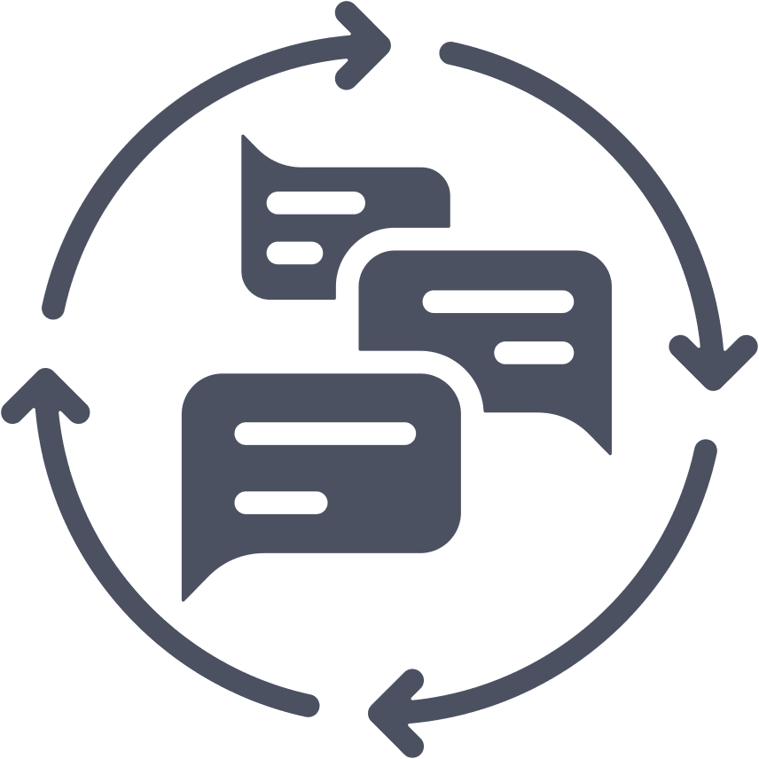

LEARNING OBJECTIVES
OBJECTIVE 1
OBJECTIVE 2
OBJECTIVE 3
Demonstrate how to respond when a patient shares a concern or negative experience, using empathy, transparency and commitment to improvement.
Identify and use appropriate hospital channels and feedback systems to document patient preferences, report disrespect and promote accountability.
Reflect on personal and team-based opportunities to improve respectful care, using patient feedback and peer input to enhance practice.
Notes:
Facilitator reads learning objectives.

Slide 137
ADDITIONAL CONTEXT
Insert additional instruction or context for each scenario here.
Notes:
Note to facilitator: Please review each scenario before presenting it to your team. You will find important details to consider in the notes section of the slides such as the description of body language and non-verbal cues. Think about how you want to guide your team through the scenarios.
You may use this optional slide or add any information unique to your facility or team that is important to this training.

Slide 138
ACCOUNTABILITY
DOMAIN
Scenario 11: Disrespectful Care

Slide 139
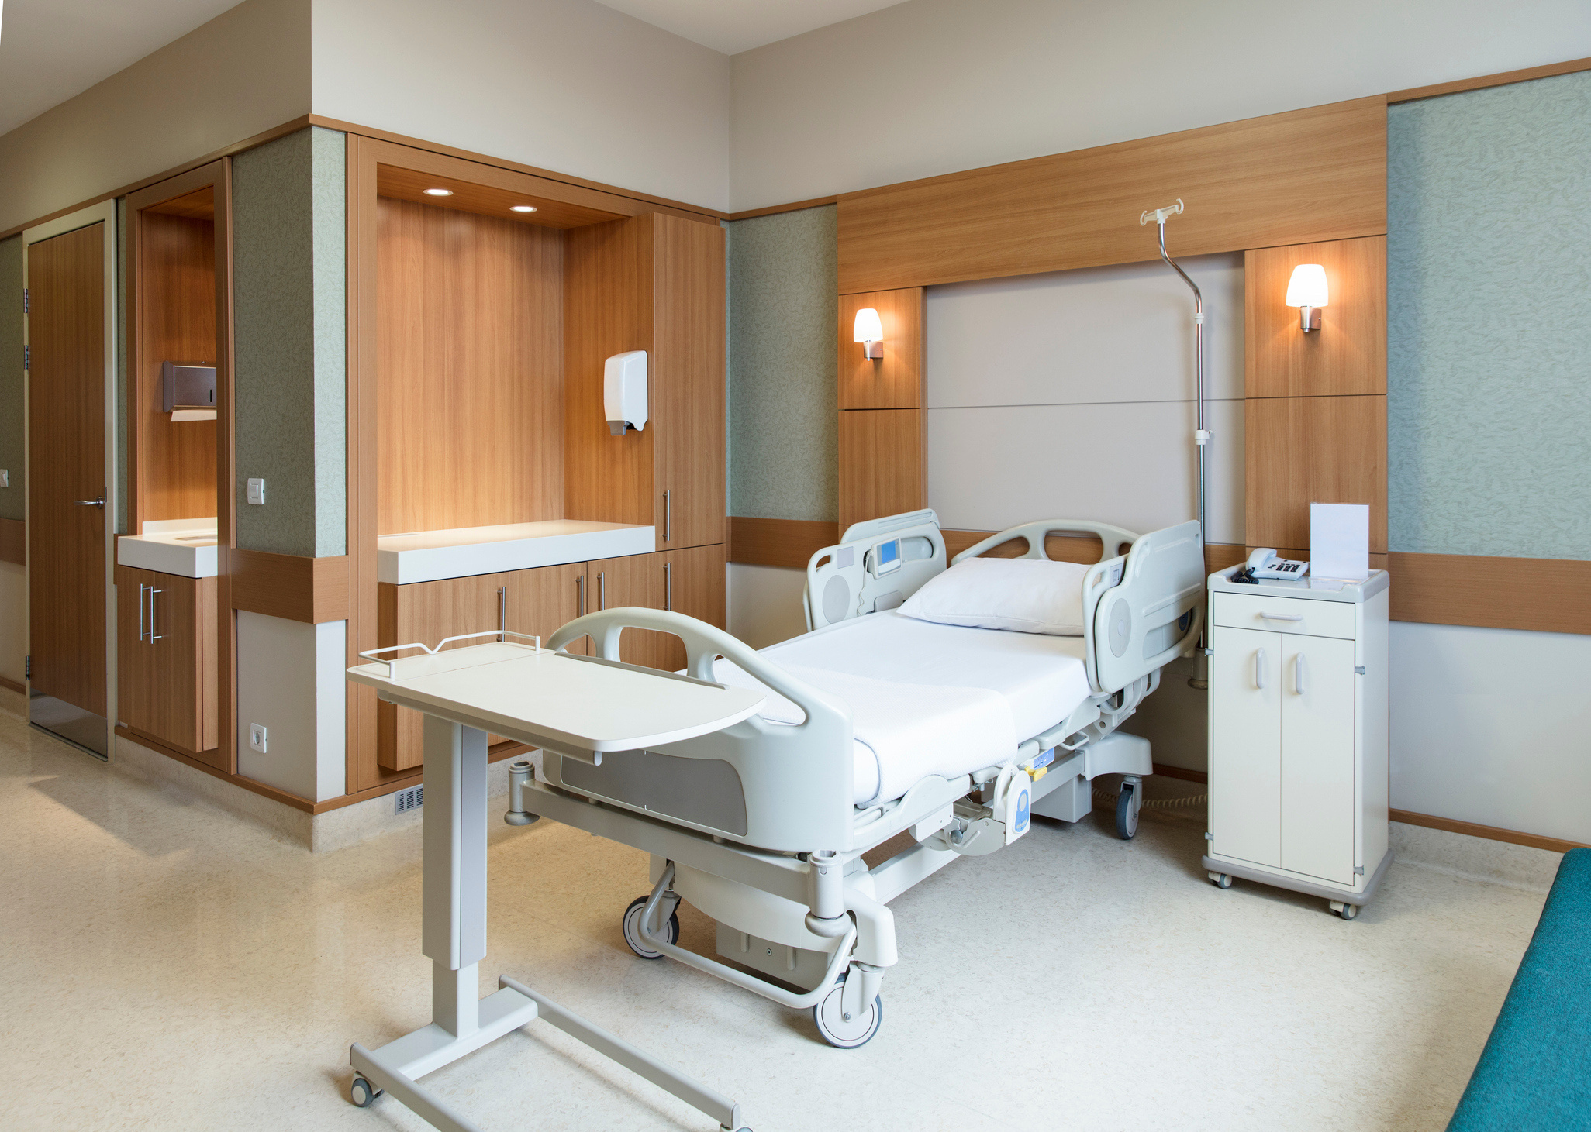

ACCOUNTABILITY: DISRESPECT
Setting:
  The patient had a cesarean delivery and is recovering in the postpartum unit. During her care, she experienced moments of rushed communication and limited engagement with her preferences. She writes a note on the hospital's comment card.
Characters:
  Charge Nurse
  Staff Nurse
Notes:
Facilitator reads the scenario setting and description of characters.

Slide 140
ACCOUNTABILITY: DISRESPECT
“Durante mi parto me sentí ignorada. Me ofrecieron la epidural cuando ya tenía mucho dolor y no entendí bien los riesgos. Me sentí presionada a decir que sí.”
The Charge Nurse collects the comment card and reads the feedback.
Notes:
Facilitator reads slide (and English translation below).
(During my labor I felt ignored. They offered the epidural when I was already in a lot of pain and I didn’t fully understand the risks. I felt pressured to say yes.)
The charge nurse collects the comment card and reads the feedback.

Slide 141

ACCOUNTABILITY: DISRESPECT
Hmm… she says she felt pressured into getting the epidural. Well, she signed the consent form, so I don’t know what else we could’ve done.
She didn’t seem upset at the time. I don’t understand why she felt this way.
Charge Nurse
Staff Nurse
Notes:
Note to facilitator: This slide has animation. Advance animation from charge nurse to staff nurse to make entire conversation visible.
Charge Nurse (to another staff nurse): “Hmm… she says she felt pressured into getting the epidural. Well, she signed the consent form, so I don’t know what else we could’ve done.”
Staff Nurse: “She didn’t seem upset at the time. I don’t understand why she felt this way.”

Slide 142
ACCOUNTABILITY: DISRESPECT
Charge Nurse places the comment card in a general feedback box but does not follow up immediately, alert leadership or document the concern. There’s no outreach to the patient, and no reflection or discussion with the care team. The patient is discharged without acknowledgment of her experience.
Notes:
Facilitator reads slide.

Slide 143

What missed opportunities for accountability did you observe in this scenario?
Notes:
Facilitator reads slide.
Facilitator may invite team members to share their observations.

Slide 144
MISSED OPPORTUNITIES FOR ACCOUNTABILITY
No investigation into the patient's perspective or steps to acknowledge harm
Patient feedback dismissed as unimportant because she signed a form
Failure to document or report the concern formally
No plan to debrief with team or improve care processes
Feedback becomes invisible, reinforcing a culture of silence
Notes:
Following reflection, Facilitator reads through missed opportunities for accountability highlighted.

Slide 145
ACCOUNTABILITY
DOMAIN
Scenario 12: Respectful Care

Slide 146
ACCOUNTABILITY: RESPECT
Setting:
  The patient had a cesarean delivery and is recovering in the postpartum unit. During her care, she experienced moments of rushed communication and limited engagement with her preferences. She writes a note on the hospital's comment card.
Characters:
  Patient: Patient: 29-year-old Black, Spanish-speaking woman named Sherice from the Dominican Republic, has Medicaid coverage for her health care.
  Charge Nurse: English-speaking, does not speak Spanish.
  Interpreter: Spanish- and English-speaking. Accessed through video.
Notes:
Facilitator reads setting and character description.

Slide 147
ACCOUNTABILITY: RESPECT
“Durante mi parto me sentí ignorada. Me ofrecieron la epidural cuando ya tenía mucho dolor y no entendí bien los riesgos. Me sentí presionada a decir que sí.”
Charge Nurse reads the patient’s comment card and pauses thoughtfully.
Notes:
Facilitator reads slide (and English translation below).
(During my labor I felt ignored. They offered the epidural when I was already in a lot of pain and I didn’t fully understand the risks. I felt pressured to say yes.)
The charge nurse reads the patient's comment card and pauses thoughtfully.

Slide 148
ACCOUNTABILITY: RESPECT
This patient felt unheard and pressured. That’s serious. We owe her a response.
Charge Nurse
Notes:
Charge Nurse (to herself): “This patient felt unheard and pressured. That’s serious. We owe her a response.”

Slide 149
ACCOUNTABILITY: RESPECT
She brings the card to the unit manager and says:
“I want to elevate this concern. It sounds like there may have been a breakdown in communication during labor. Even though the consent form was signed, the patient’s perception matters and we should find out what happened.”
The charge nurse then returns to the patient's room with the Spanish interpreter on video to follow up.
Notes:
Facilitator reads slide.

Slide 150
ACCOUNTABILITY: RESPECT
Thank you for taking the time to share your experience. I read your feedback and want to say I’m sorry that you felt pressured and unheard during your labor. That’s not the experience we want for you.
Gracias. Sentí que nadie me explicó bien las cosas.
Video Interpreter
I hear you. We are responsible for making sure every person understands their choices, especially during such an important moment. I will document your feedback and make sure it’s shared with our patient safety and equity teams so we can address what happened and make improvements.
She also offers the patient a follow-up contact to the hospital’s patient advocate.
Patient
Notes:
Note to facilitator: This slide has animation. Advance animation from charge nurse to patient, back to charge nurse to make entire conversation visible.
Charge Nurse (gently, through interpreter):
“Thank you for taking the time to share your experience. I read your feedback and want to say I’m sorry that you felt pressured and unheard during your labor. That’s not the experience we want for you.”
Patient (softly):
“Gracias. Sentí que nadie me explicó bien las cosas.”
(Thank you. I felt like no one really explained things clearly.)
Charge Nurse:
“I hear you. We are responsible for making sure every person understands their choices, especially during such an important moment. I will document your feedback and make sure it’s shared with our patient safety and equity teams so we can address what happened and make improvements.”
She also offers the patient a follow-up contact to the hospital’s patient advocate.

Slide 151
ACCOUNTABILITY: RESPECT
Later, she:
  Submits a patient safety report describing the patient’s concern
  Documents the feedback in the medical record under postpartum notes
  Flags it for the unit’s monthly quality and equity huddle
  Speaks with the anesthesiology and Labor and Delivery nursing team to reflect on how communication during procedures can be improved
Notes:
Facilitator reads slide.

Slide 152
What key practices of accountability did you observe in this scenario?
Notes:
Facilitator reads slide.
Facilitator may invite team members to share their observations.

Slide 153
KEY PRACTICES OF ACCOUNTABILITY
Respect the patient’s feedback as valid, regardless of whether harm was intended
Apologize sincerely for the impact of the experience
Report the concern to institutional channels (patient safety, equity office, etc.)
Document patient concerns clearly and transparently
Engage in unit-based reflection to learn from the experience
Connect the patient with advocacy resources when appropriate
Use feedback to spark improvement, not to assign blame, but to promote better care
Notes:
Following reflection, Facilitator reads through key practices of accountability.

Slide 154
FURTHER REFLECTION AND DISCUSSION
  How does your team currently gather and act on patient feedback? Where is that feedback stored, and who sees it?
  What is one example of a time when you or a colleague took accountability for a misstep? What impact did that have on the patient or the team?
  What systems are in place to report bias or mistreatment on your unit, and are they trusted and used by staff?
  How can we cultivate a culture where feedback is welcomed, not feared, and accountability is a strength, not a weakness?
Notes:
Note to facilitator: This is the last slide in the Accountability section. Here are some ideas to assist with further reflection and discussion on this scenario with your group. For additional ideas, please review the Accountability Domain in the Resource Guide.

Slide 155
NEXT STEPS
Next steps content
Notes:
Note to facilitator: This is an optional slide for you to identify next steps for your team.

