Slide 1



CHECK OUT THE PLATFORM!
Attendee Chat
Ask a Question
Related Content
LIVE CLOSED CAPTIONING AVAILABLE
TIP: RESIZE WINDOWS TO CUSTOMIZE THE EXPERIENCE

Slide 2


Creating a Culture of Respectful Maternity Care:
Introducing the NICHQ Respectful Maternity Care Toolkit

Slide 3
Agenda
Welcome & Introduction | Dr. Stacy Scott, PhD, MPA Vice President, NICHQ
Toolkit Purpose, Structure, & Audience | Jacqueline Kellachan, MPH Project Director, NICHQ
Domains of Respectful Maternity Care | Dr. Stacy Scott, PhD, MPA Vice President, NICHQ
Using the Toolkit in Clinical Settings | Dr. Zsakeba Henderson, MD FACOG Principal, ESW Consultants
Evaluation | Becky Russell, MSPH Vice President, NICHQ
Questions & Next Steps | Jacqueline Kellachan, MPH Project Director, NICHQ

Slide 4
FUNDING ACKNOWLEDGEMENT
This presentation is supported by the Centers for Disease Control and Prevention (CDC) of the U.S. Department of Health and Human Services (HHS) as part of a financial assistance subaward totaling $450,000 with 100 percent funded by CDC/HHS. The contents are those of the author(s) and do not necessarily represent the views of, nor an endorsement by, CDC/HHS, or the U.S. Government.

Slide 5
ACKNOWLEDGEMENT
The National Institute for Children’s Health Quality (NICHQ) developed the RMC Toolkit in March 2026. We acknowledge and appreciate the expertise provided by the NICHQ Respectful Maternity Care Toolkit Workgroup Members.

Slide 6
What is Respectful Maternity Care?
Respectful maternity care (RMC) means that every woman giving birth:​
Is treated with dignity and compassion​
Receives clear, honest communication​
Is supported in making informed decisions​
Has their preferences and cultural context respected​
Feels safe and heard throughout their care journey​
Respectful maternity care is not a single intervention—it is a clinical culture and a set of daily behaviors practiced by care teams.

Slide 7
Why Respectful Maternity Care Matters
Respectful maternity care is essential for:
Patient safety
Trust in the healthcare system
Improved maternal outcomes
High-quality clinical decision-making
Mistreatment during childbirth has been documented across many settings and is associated with poorer patient experience, decreased trust in clinicians and reduced engagement in care

Slide 8
National Organizations
Alliance for Innovation on Maternal Health (AIM)
American College of Obstetricians and Gynecologists (ACOG)
Association of Women’s Health, Obstetric and Neonatal Nurses (AWHONN)
American College of Nurse Midwives (ACNM)
Centers for Disease Control and Prevention (CDC)
Health Resources and Services Administration (HRSA)
And many more......

Slide 9


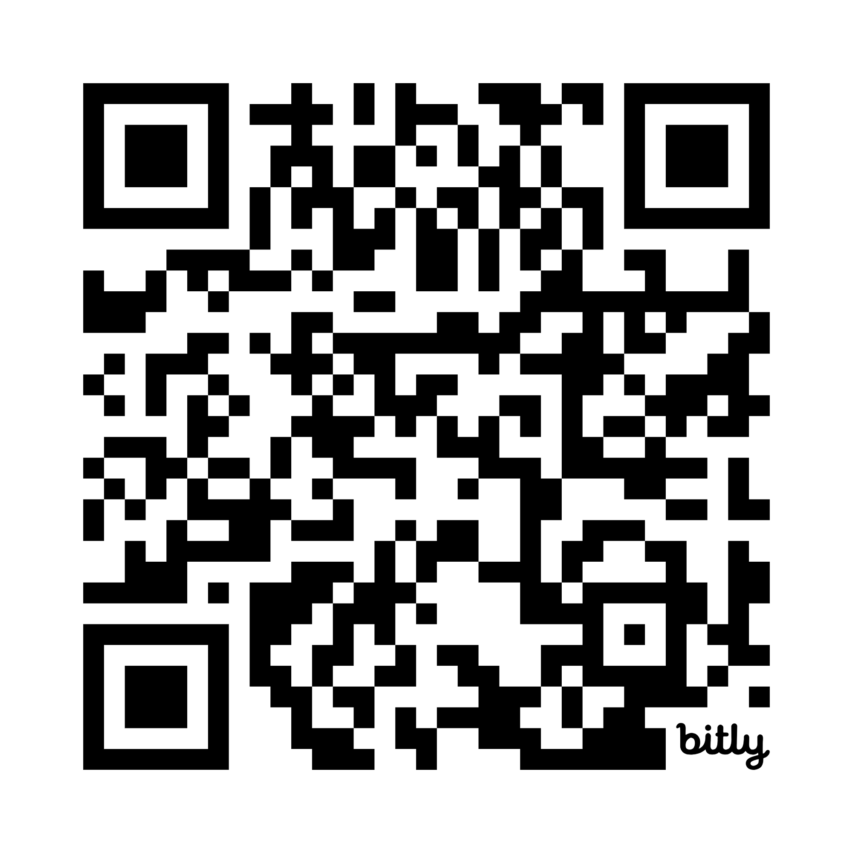
Agency for Healthcare Research
and Quality’s Safety Program for
Perinatal Care Toolkit​
Focus on teamwork and communication​
Uses scenario-based training​
Emphasizes culture change​
Supports unit-level implementation​
Connects behavior change to patient safety outcomes
Link to SPPC-II Toolkit
Notes:
https://www.ahrq.gov/patient-safety/settings/labor-delivery/perinatal-care-2/index.html

Slide 10
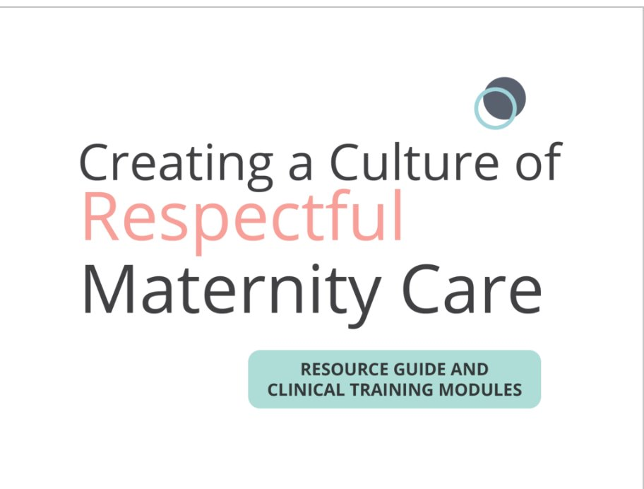
NICHQ RMC Toolkit
NICHQ RMC Toolkit Working Group

Slide 11
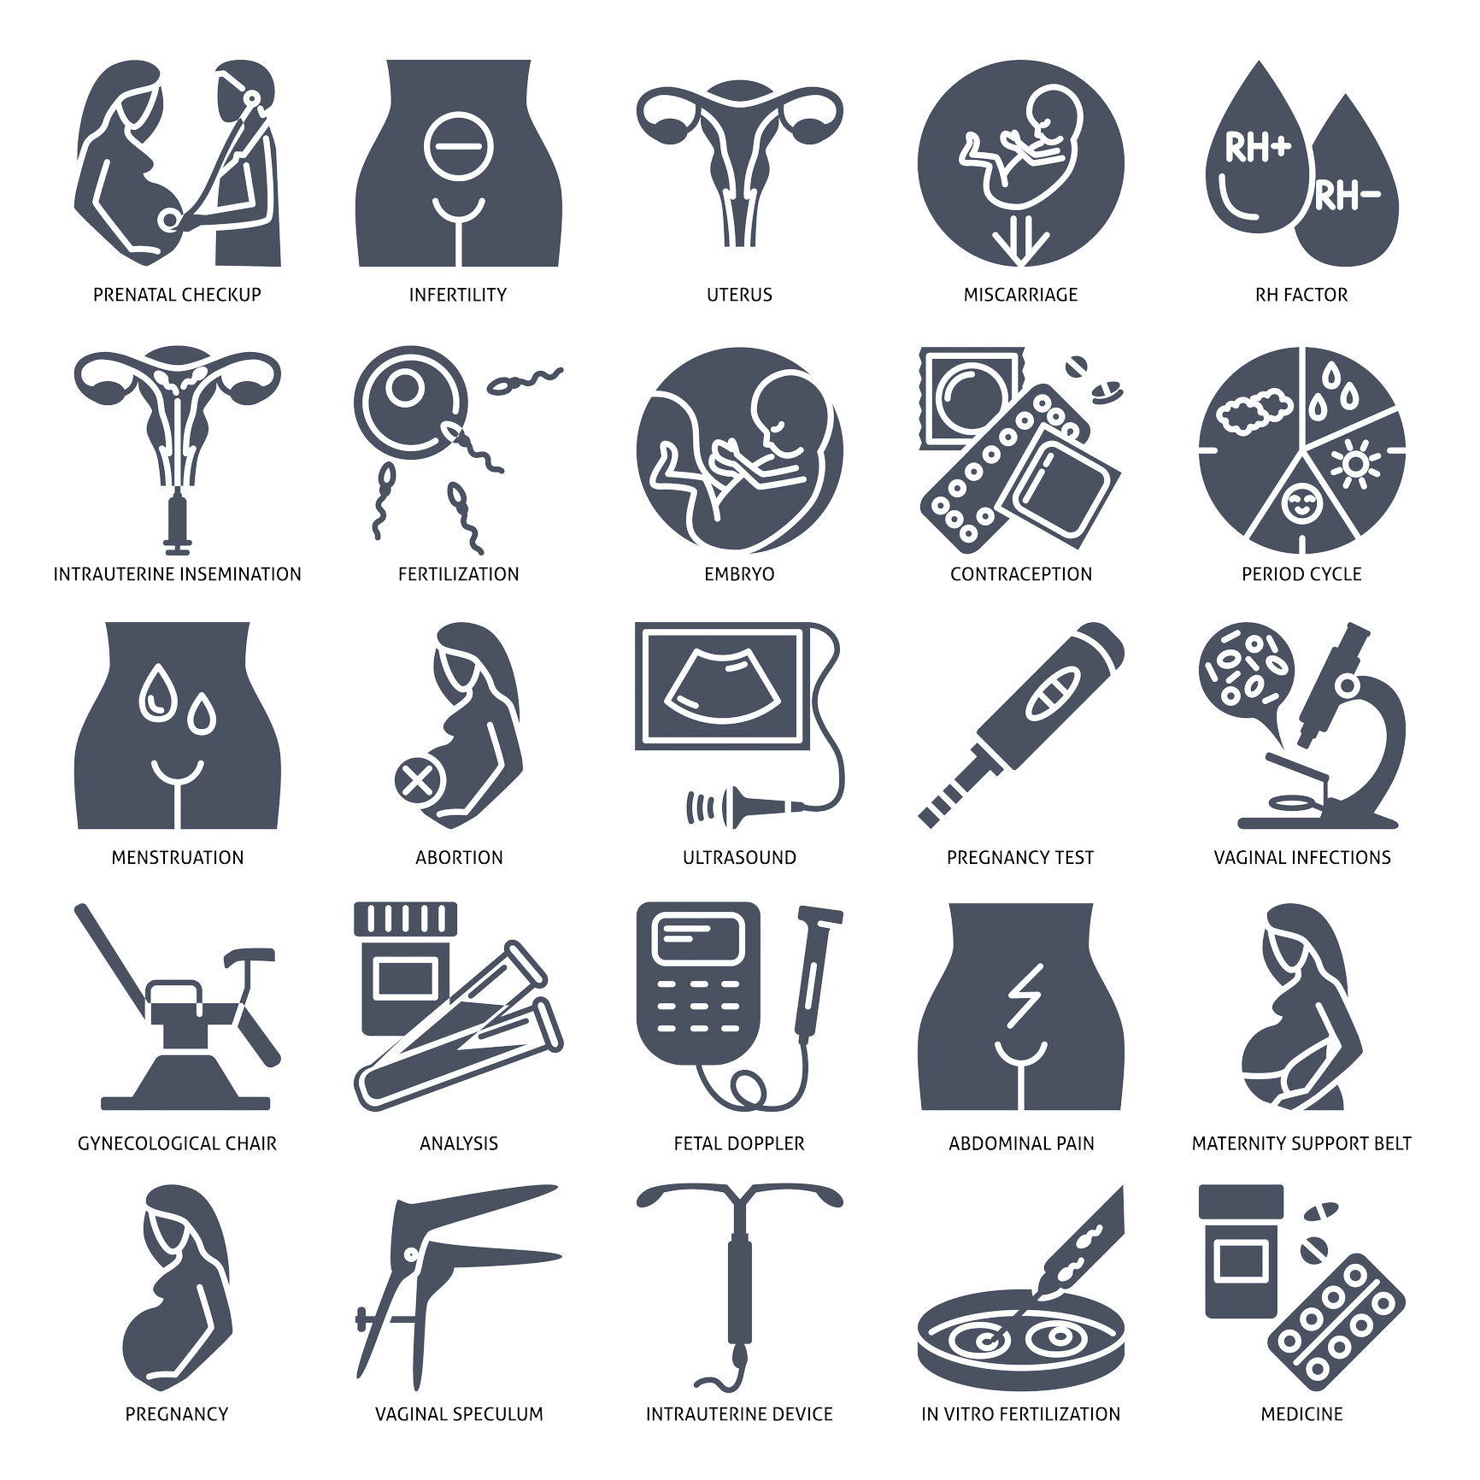
Toolkit Purpose, Structure, & Audience

Slide 12
Purpose of Toolkit
The NICHQ Respectful Maternity Care toolkit was developed to support clinicians and health systems in integrating respectful, patient- centered practices into maternity care.​
The toolkit:​
Provides practical strategies for clinicians​
Supports team-based practice change​
Helps institutions assess respectful care​
Connects respectful care practices with measurable outcomes​
The toolkit is organized around key domains of respectful maternity care, each with specific strategies and evaluation tools.

Slide 13
Who Should Use This Toolkit?
Individuals
Including clinicians who want to reflect on their practice and adopt respectful, patient-centered behaviors in their daily work
Clinical Teams
Such as labor and delivery units, quality improvement (QI) teams or cross-disciplinary groups working together to strengthen communication, promote shared decision-making and ensure consistent respectful care across the maternity care experience
Clinical Leadership
While the primary audience for this toolkit is clinical staff, hospital leaders play a critical role in sustaining change. Leadership engagement is essential to addressing structural barriers, supporting staff and embedding respectful maternity care into the culture of the institution – not just the individual practice.

Slide 14
Structure of Toolkit
The toolkit includes two complementary components:​
RMC Resource Guide​: A reference document that outlines respectful care principles, clinical behaviors and evaluation strategies.​
RMC Clinical Training Modules​: Interactive training materials designed to help clinicians practice and reflect on respectful care behaviors.​
​
Together these tools support education, practice change, and measurement of respectful maternity care.

Slide 15
Domains of Respectful Maternity Care
Notes:
Note: Re-word this – RMC Resource Guide: Domains of Respectful Maternity Care

Slide 16
Domains of Respectful Maternity Care
The toolkit organizes respectful care into five domains:​
Dignity​
Communication​
Autonomy in Decision-Making​
Informed Consent​
Accountability​
Each domain includes practical strategies and evaluation approaches for clinical teams.

Slide 17
Dignity
Dignity in maternity care includes:​
Freedom from verbal abuse, coercion, or discrimination​
Protection of privacy during examinations and procedures​
Respect for cultural beliefs and personal preferences​
Recognition of the emotional and physical vulnerability of childbirth​
Dignity means recognizing and affirming the inherent worth of every maternity patient regardless of race, ethnicity, gender, language, insurance status, age or ability.

Slide 18
Communication
Respectful communication requires clinicians to:​
Listen actively to patient concerns​
Use plain language instead of medical jargon​
Ask open-ended questions​
Invite patients and support people to participate in discussions​
Clear communication helps ensure patients feel informed, heard, and supported throughout care.

Slide 19
Autonomy in Decision-Making
Respectful care supports patients’ rights to make decisions about their bodies and their care.​ Clinical teams should:​
Encourage questions​
Explore patient preferences​
Provide options and alternatives​
Support shared decision-making​
Autonomy is especially important during moments of clinical uncertainty or urgency.
Notes:
Note: state laws
https://www.propublica.org/article/florida-court-ordered-c-sections
https://www.acog.org/clinical-information/policy-and-position-statements/position-statements/2025/life-sustaining-care-and-advance-directives-for-pregnant-patients

Slide 20
Informed Consent
Informed consent is not simply a signed form.​ It is an ongoing conversation between patients and care teams that includes:​
Clear explanation of options​
Discussion of risks and benefits​
Time for questions and reflection​
Revisiting consent as care evolves​
Meaningful consent helps patients remain active participants in their care.
Notes:
Note: state laws
https://www.propublica.org/article/florida-court-ordered-c-sections
https://www.acog.org/clinical-information/policy-and-position-statements/position-statements/2025/life-sustaining-care-and-advance-directives-for-pregnant-patients

Slide 21
Accountability
Sustained respectful care requires accountability at multiple levels:​
Individual clinicians​
Care teams​
Unit leadership​
Hospital administration​
Community stakeholders​
Accountability is the obligation of providers and healthcare systems to uphold the rights, dignity, and autonomy of maternity patients through transparent and answerable mechanisms.

Slide 22
How to Use This Toolkit
Notes:
Clinical teams are operating in high-pressure environments with limited time and capacity​. This toolkit was designed with that reality in mind

Slide 23
Start Small, Think Big
Each respectful care domain in the toolkit can be used independently or integrated into broader quality improvement or safety initiatives.​
Choose a domain of focus and a practice change at the individual or team level.​
Test the change with your team using a scenario in clinical module and reflect on the change in the behavior or process​
Do a small test of change with patients and collect feedback from your team and your patients
​

Slide 24
Using the Toolkit in Clinical Settings

Slide 25
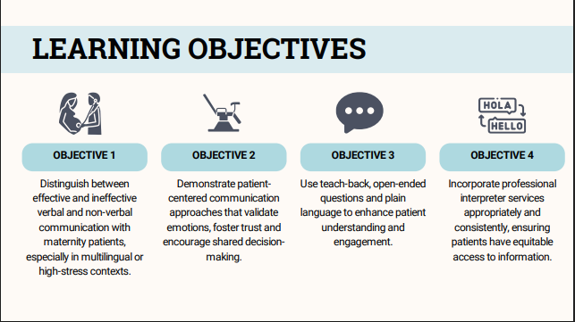
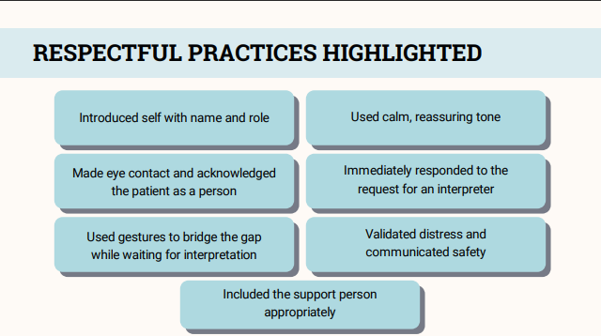
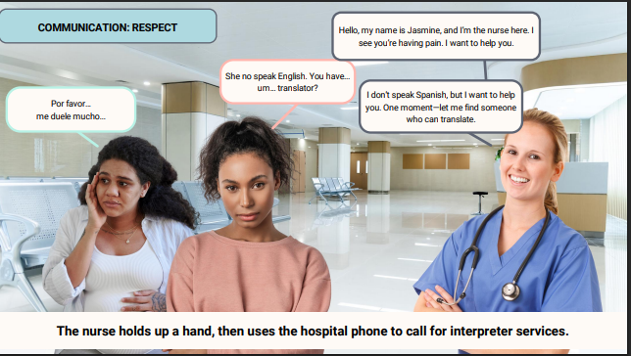
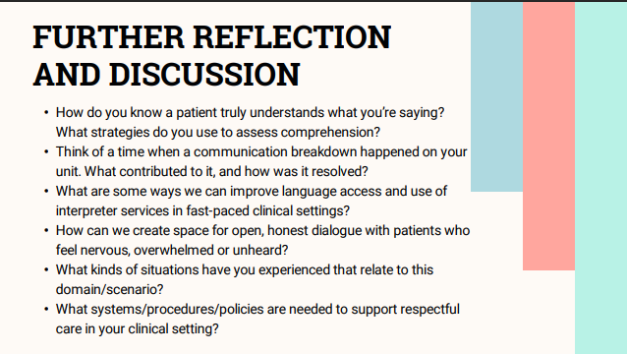
Clinical Modules
Six clinical modules centered on each of the care domains and aligned with key stages of the birth journey.
Each module includes:
  Learning objectives
  Paired scenarios: the same clinical scenario shown in two ways:
    Disrespectful care practices
    Respectful, patient-centered care practices
  Practice highlights: key RMC behaviors and approaches demonstrated
  Reflection and discussion questions to support team dialogue and application

Slide 26
What To Expect
The clinical scenarios are designed for training and reflection on respectful maternity care practices.
While they may not mirror any one clinician’s exact experience, they do reflect real situations that can occur in clinical settings.
Some examples of disrespectful care may seem obvious, and other behaviors more subtle.
  Even small actions or omissions can significantly impact a patient’s experience, sense of safety and dignity.
  Clinical modules are designed to help teams reflect on how to consistently integrate respectful, patient-centered practices into everyday care

Slide 27
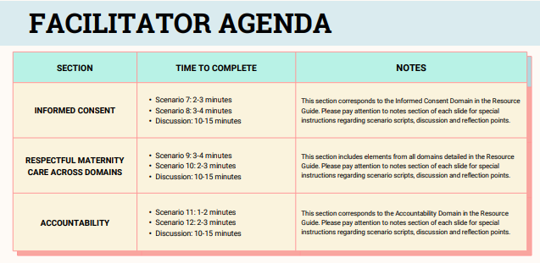

How to Use the Modules
Designed for Flexible, Team-Based Learning
  Include facilitator instructions and notes to support use
  Can be used for team discussion, role-play or simulation-based training
  Uses paired scenarios to compare care approaches in real time
  Prioritizes reflection and team discussion
  Encourages teams to adapt discussions to their context, workflows and patient population

Slide 28
Examples of Learning Objectives
Communication
Distinguish between effective and ineffective verbal and non-verbal communication with maternity patients, especially in multilingual or high-stress contexts.
Autonomy in Decision-Making
Demonstrate how to engage patients in collaborative care planning that respects their values, preferences and lived experiences.
RMC Across Domains
Describe how to preserve patient dignity during delivery and the immediate postpartum period, even in urgent or high-pressure situations.
.
Dignity
Identify behaviors and language that can affirm patient dignity during maternity care.
Informed Consent
Practice reaffirming consent at key decision points, using language that checks patient understanding of and comfort with the plan.
Accountability
Identify and use appropriate hospital channels and feedback systems to document patient preferences, report disrespect and promote accountability.

Slide 29
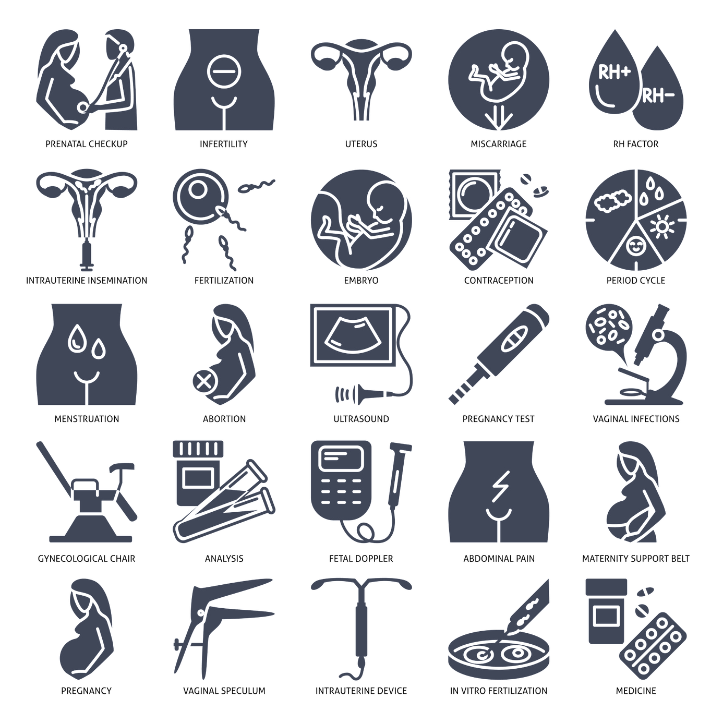
DIGNITY: LEARNING OBJECTIVES
OBJECTIVE 1
OBJECTIVE 2
OBJECTIVE 3
OBJECTIVE 4
Identify behaviors and language that can affirm patient dignity during maternity care.
Describe the impact of maintaining privacy, respectful tone and acknowledging patient identity on maternal health experiences and outcomes.
Practice responding to patient emotions and fears in ways that promote compassion and humanize care.
Demonstrate strategies to preserve patient dignity even during high-stress or emergency clinical situations.
Notes:
Facilitator reads learning objectives.

Slide 30
What This Looks Like in Practice

Slide 31
DIGNITY DOMAIN
Scenario 3: Disrespectful Care

Slide 32
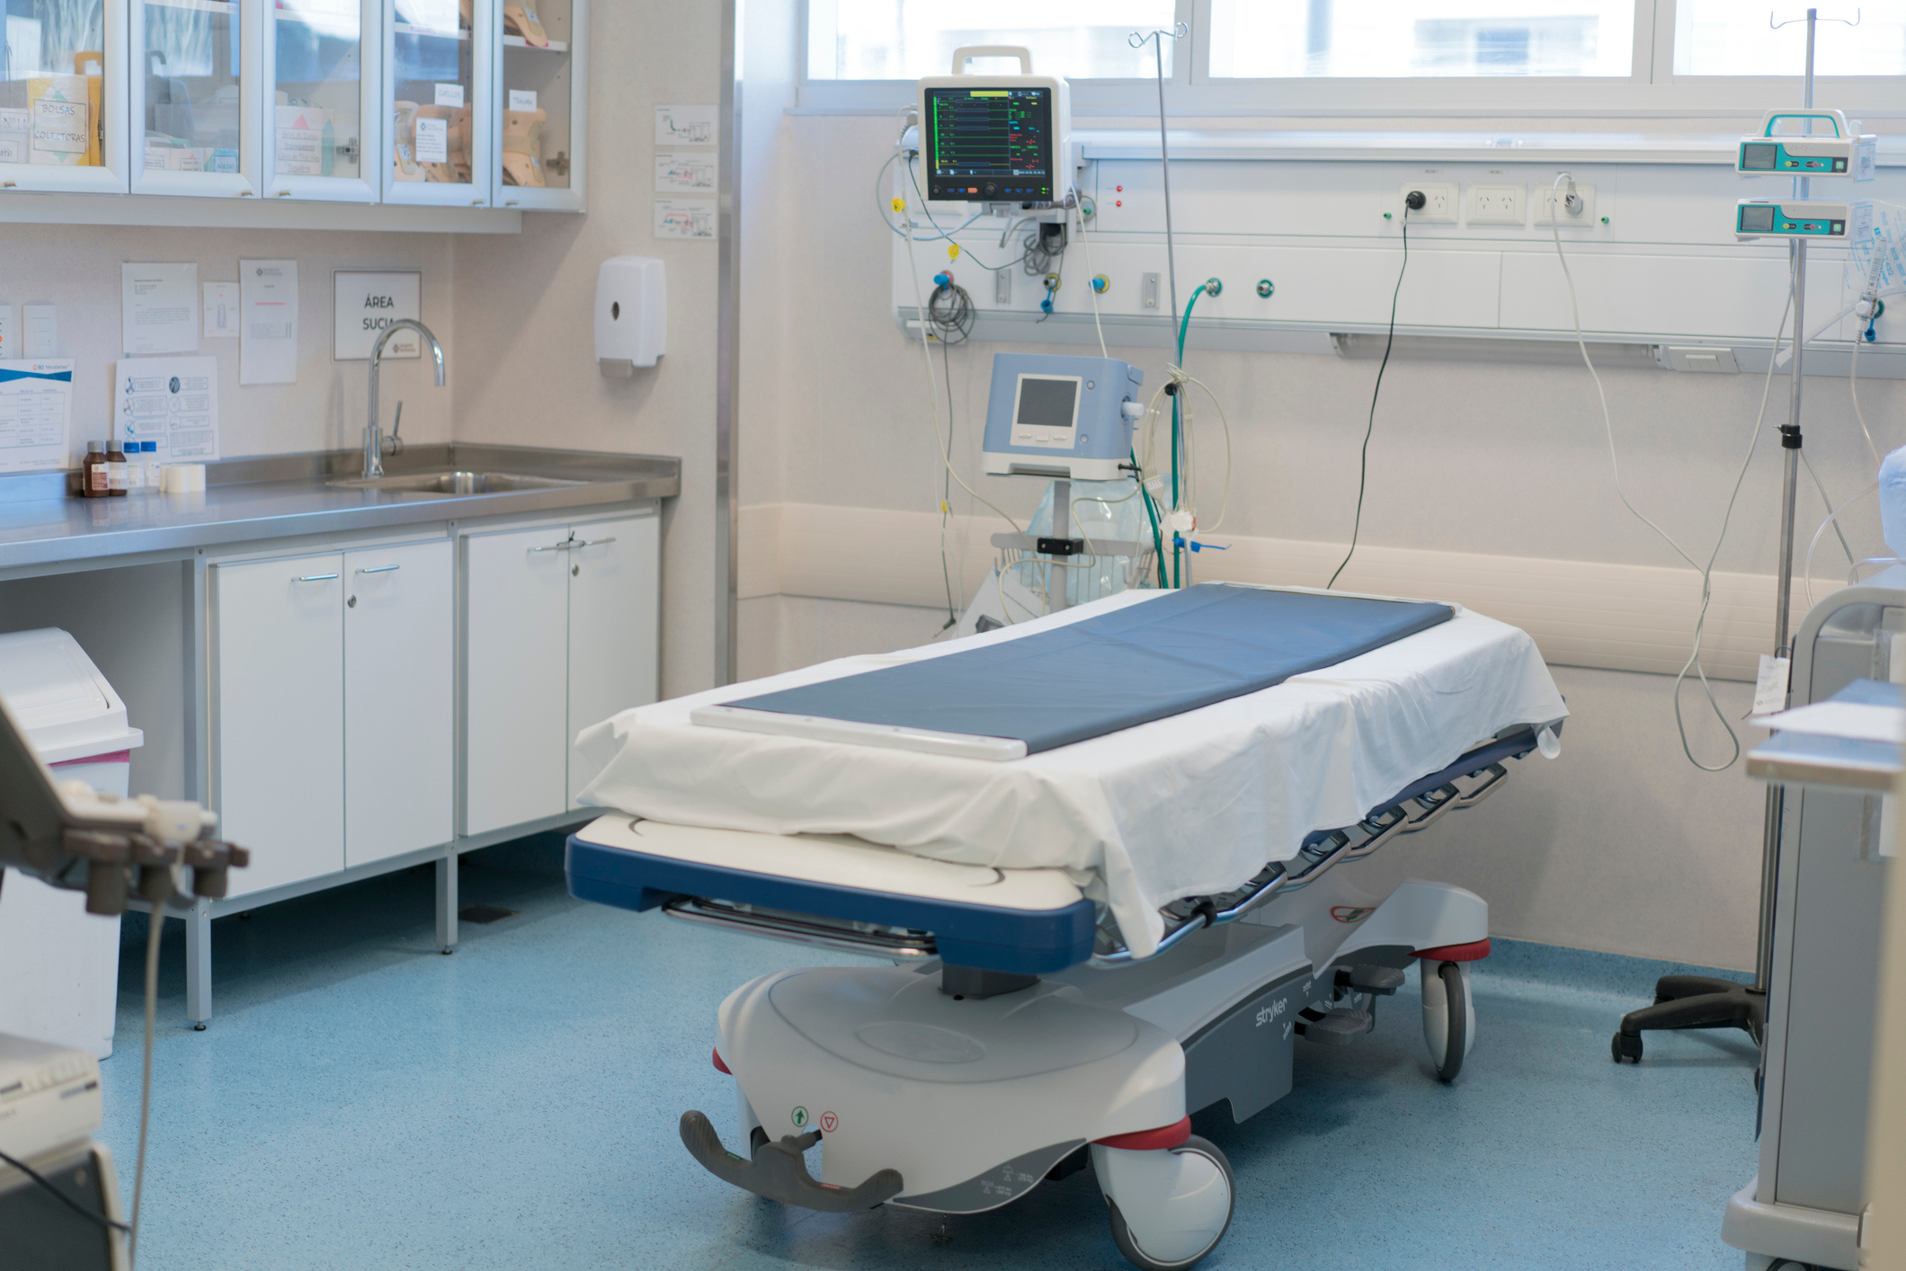

DIGNITY: DISRESPECT
Setting:
  Same triage room. Sherice is lying on the bed in pain. The nurse has already asked some questions with the interpreter. The provider arrives.
Characters:
  Patient: 29-year-old Black, Spanish-speaking woman named Sherice from the Dominican Republic, has Medicaid coverage for her health care.
  Support Person: Her cousin, who is also Spanish-speaking and who speaks limited English.
  Obstetrician: English-speaking, does not speak Spanish.
  Interpreter: Spanish and English-speaking. Accessed through video.

Slide 33




DIGNITY: DISRESPECT
Okay. Let’s see what’s going on.
Video Interpreter
Physician
Patient
Interpreter interprets the entire conversation with the obstetrician in Spanish.
Support Person
Notes:
Note to facilitator: This slide has animation. Advance animation from provider to interpreter to make entire conversation visible.
Provider (walks in briskly, no eye contact): Okay. Let’s see what’s going on.
Interpreter (interprets the entire conversation with the provider in Spanish)

Slide 34
DIGNITY: DISRESPECT
I’m going to check you now.
She… want privacy…
¿Aquí? Hay gente…
Ok, sorry about that.
The obstetrician closes the curtain while starting to reach and lift the patient’s gown for the exam.
Notes:
Note to facilitator: This slide has animation. Advance animation from provider to patient to support person to provider to make entire conversation visible.
Provider (snapping gloves on, speaking quickly): I’m going to check you now.
Patient (anxious): ¿Aquí? Hay gente…
(Here? There are people…)
Support person (Cousin): She… want privacy…
Provider (glancing around, dismissive): Ok, sorry about that (closes curtain, while starting to reach and lift patient’s gown for the exam)

Slide 35
DIGNITY: DISRESPECT
This exam should not hurt if you just let your legs flop apart and relax.
The obstetrician proceeds to start the exam.
Notes:
Provider: This exam should not hurt if you just let your legs flop apart and relax (proceeds to start exam).

Slide 36
DIGNITY: DISRESPECT
Por favor…
Relax. If you don’t relax the exam will be uncomfortable and I won’t be able to tell how far along you are.
The patient is visibly tense, squeezing her cousin’s hand.
Notes:
Note to facilitator: This slide has animation. Advance animation from patient to provider, back to patient to make entire conversation visible.
Patient (uncomfortable, tears in eyes): Por favor…
Provider: Relax. If you don’t relax the exam will be uncomfortable and I won’t be able to tell how far along you are.
Patient (visibly tense, squeezing her cousin’s hand)

Slide 37
DIGNITY: DISRESPECT
You’re barely dilated. You aren’t in real labor yet. Just wait and we will check you again in a bit.
The patient is lying there, exposed, crying softly.
Notes:
Provider (finishes quickly, stands to leave): You’re barely dilated. You aren’t in real labor yet. Just wait and we will check you again in a bit.
Patient: Lying there, exposed, crying softly.

Slide 38
DISRESPECTFUL PRACTICES HIGHLIGHTED
No introduction or use of her name
No explanation before touching
Dismisses request for privacy
No draping or effort to cover her
No empathy or emotional support
Rushes and is rough
Talks about her loudly in front of others

Slide 39
DIGNITY DOMAIN
Scenario 4: Respectful Care

Slide 40
DIGNITY: RESPECT
Setting:
  Same triage room. Provider arrives after nurse has completed intake with interpreter.
Characters:
  Patient: 29-year-old Black, Spanish-speaking woman named Sherice from the Dominican Republic, has Medicaid coverage for her health care.
  Support Person: Her cousin, who is also Spanish-speaking and who speaks limited English.
  Obstetrician: English-speaking, does not speak Spanish.
  Interpreter: Spanish and English-speaking. Accessed through video.
Notes:
Facilitator reads setting and character description.

Slide 41

DIGNITY: RESPECT
Hi. May I come in?
Sí…
Hello, Sherice. My name is Dr. López. I’m here to take care of you.
Gracias…
Video Interpreter
Patient
Interpreter interprets the entire conversation with the obstetrician in Spanish.
Support Person
Physician
Notes:
Note to facilitator: This slide has animation. Advance animation from provider to interpreter, back to provider to make entire conversation visible.
Provider (knocks gently before entering): Hi. May I come in?
Interpreter (interprets the entire conversation with the provider in Spanish):
Patient (weakly): Sí…
Provider (comes in slowly, eye contact): Hello, Sherice. My name is Dr. López. I’m here to take care of you. [Sits at her level]
Patient: Gracias…

Slide 42
DIGNITY: RESPECT
I know you’re in pain. I want to make sure you and your baby are okay.
Está bien…
Notes:
Note to facilitator: This slide has animation. Advance animation from provider to patient to make entire conversation visible.
Provider (warm tone): I know you’re in pain. I want to make sure you and your baby are okay.
Patient (tearful): Está bien…
(it’s fine…)

Slide 43
DIGNITY: RESPECT
Thank you both for being here. Sherice, would you like your cousin to stay during the exam, or wait outside?
Quiero que se quede…
Of course. Your choice. She can stay.
Notes:
Note to facilitator: This slide has animation. Advance animation from provider to patient, back to provider to make entire conversation visible.
Provider (looks at both patient and support person): Thank you both for being here. Sherice, would you like your cousin to stay during the exam, or wait outside?
Patient: Quiero que se quede…
(I want her to stay…)
Provider (nodding): Of course. Your choice. She can stay.

Slide 44
DIGNITY: RESPECT
Before we start, can you tell me what worries you most right now?
El bebé… quiero saber si está bien…
Notes:
Note to facilitator: This slide has animation. Advance animation from provider to patient to make entire conversation visible.
Provider (calm, respectful): Before we start, can you tell me what worries you most right now?
Patient: El bebé… quiero saber si está bien…
(The baby… I want to know if he’s okay…)

Slide 45
DIGNITY: RESPECT
That is very important. Everything looks good right now on the monitor. We will continue to check your baby to make sure all is well. I also need to examine you to see if you are in labor. We’ll do this as privately as we can.
The obstetrician looks around and closes the curtain fully.
Notes:
Provider (softly):
That is very important. Everything looks good right now on the monitor. We will continue to check your baby to make sure all is well. I also need to examine you to see if you are in labor. We’ll do this as privately as we can. [Looks around, closes curtain fully]

Slide 46
DIGNITY: RESPECT
Let’s make sure you’re covered.
The obstetrician uses a sheet to drape her carefully.
Notes:
Provider: Let’s make sure you’re covered. [Uses sheet to drape her carefully].

Slide 47
DIGNITY: RESPECT
Is it ok if I examine you now?
Sí…
I’ll tell you each step before I do anything. If you want me to stop at any time, just say so.
Está bien… gracias…
Are you ready for me to begin?
Sí.
Notes:
Note to facilitator: This slide has animation. Advance animation from provider to patient make entire conversation visible.
Provider: Is it ok if I examine you now?
Patient (nods) :Sí
(yes)
Provider (calm voice): I’ll tell you each step before I do anything. If you want me to stop at any time, just say so.
Patient (nods) : Está bien… gracias…
(it’s fine… thanks…)
Provider (makes gentle eye contact): Are you ready for me to begin?
Patient: Sí.
(yes)

Slide 48
DIGNITY: RESPECT
You’re doing well. Thank you for letting me check. I’m being very gentle. All done. You are about one centimeter dilated, in early labor.
The obstetrician completes the exam.
Notes:
Provider (during exam, calm tone): You’re doing well. Thank you for letting me check. I’m being very gentle.
Provider completes the exam.
Provider: All done. You are about one centimeter dilated, in early labor.

Slide 49
DIGNITY: RESPECT
We’ll talk now about your options for comfort and next steps. Do you have any questions for me?
De nada. Estamos aquí para usted.
You’re welcome. We’re here for you.
No… gracias, doctor…
Notes:
Note to facilitator: This slide has animation. Advance animation from provider to patient, back to provider and to interpreter to make entire conversation visible.
Provider (warm smile): We’ll talk now about your options for comfort and next steps. Do you have any questions for me?
Patient (visibly calmer): No… gracias, doctor…
(No… Thank you, Doctor..)
Provider: You’re welcome. We’re here for you.
Interpreter:
De nada. Estamos aquí para usted.
(you’re welcome. We’re here for you).

Slide 50
RESPECTFUL PRACTICES HIGHLIGHTED
Knocked before entering
Introduced self by name and role
Sat at eye level, made eye contact
Used preferred language (through interpreter)
Asked about support person’s presence—honored choice
Closed curtain for privacy
Notes:
Following reflection, Facilitator reads respectful practices highlighted.

Slide 51
RESPECTFUL PRACTICES HIGHLIGHTED
Draped patient to protect modesty
Explained exam steps in plain language
Asked permission before doing exam
Checked in during exam, reassured the patient, used gentle tone
Communicated results of the exam and offered time for questions
Addressed emotional worries
Notes:
Following reflection, Facilitator reads respectful practices highlighted.

Slide 52
FURTHER REFLECTION AND DISCUSSION
  Can you recall a time when you or your team preserved a patient's dignity in a high-stress situation? What did that look like?
  What types of language, tone or body language might unintentionally strip a patient of dignity during labor or birth?
  How do institutional policies or environments (e.g., overcrowding, time constraints, lack of privacy) make it harder to uphold dignity—and how can we navigate those constraints?
  How do race, language, religion, socioeconomic status or prior trauma influence a person’s perception of dignity in health care? (e.g., what feels dignified can vary based on cultural and personal values.)
Notes:
Note to facilitator: This is the last slide in the Dignity section. Here are some ideas to assist with further reflection and discussion on this scenario with your group. For additional ideas, please review the Dignity Domain in the Resource Guide.

Slide 53
Evaluation

Slide 54
Evaluation
The guide includes domain-specific strategies to help teams evaluate whether patients are receiving respectful care in clinical settings:
Evaluation Objectives
Process Measures
Outcome/Experience Measures
Suggested Instruments

Slide 55


Questions?

Slide 56
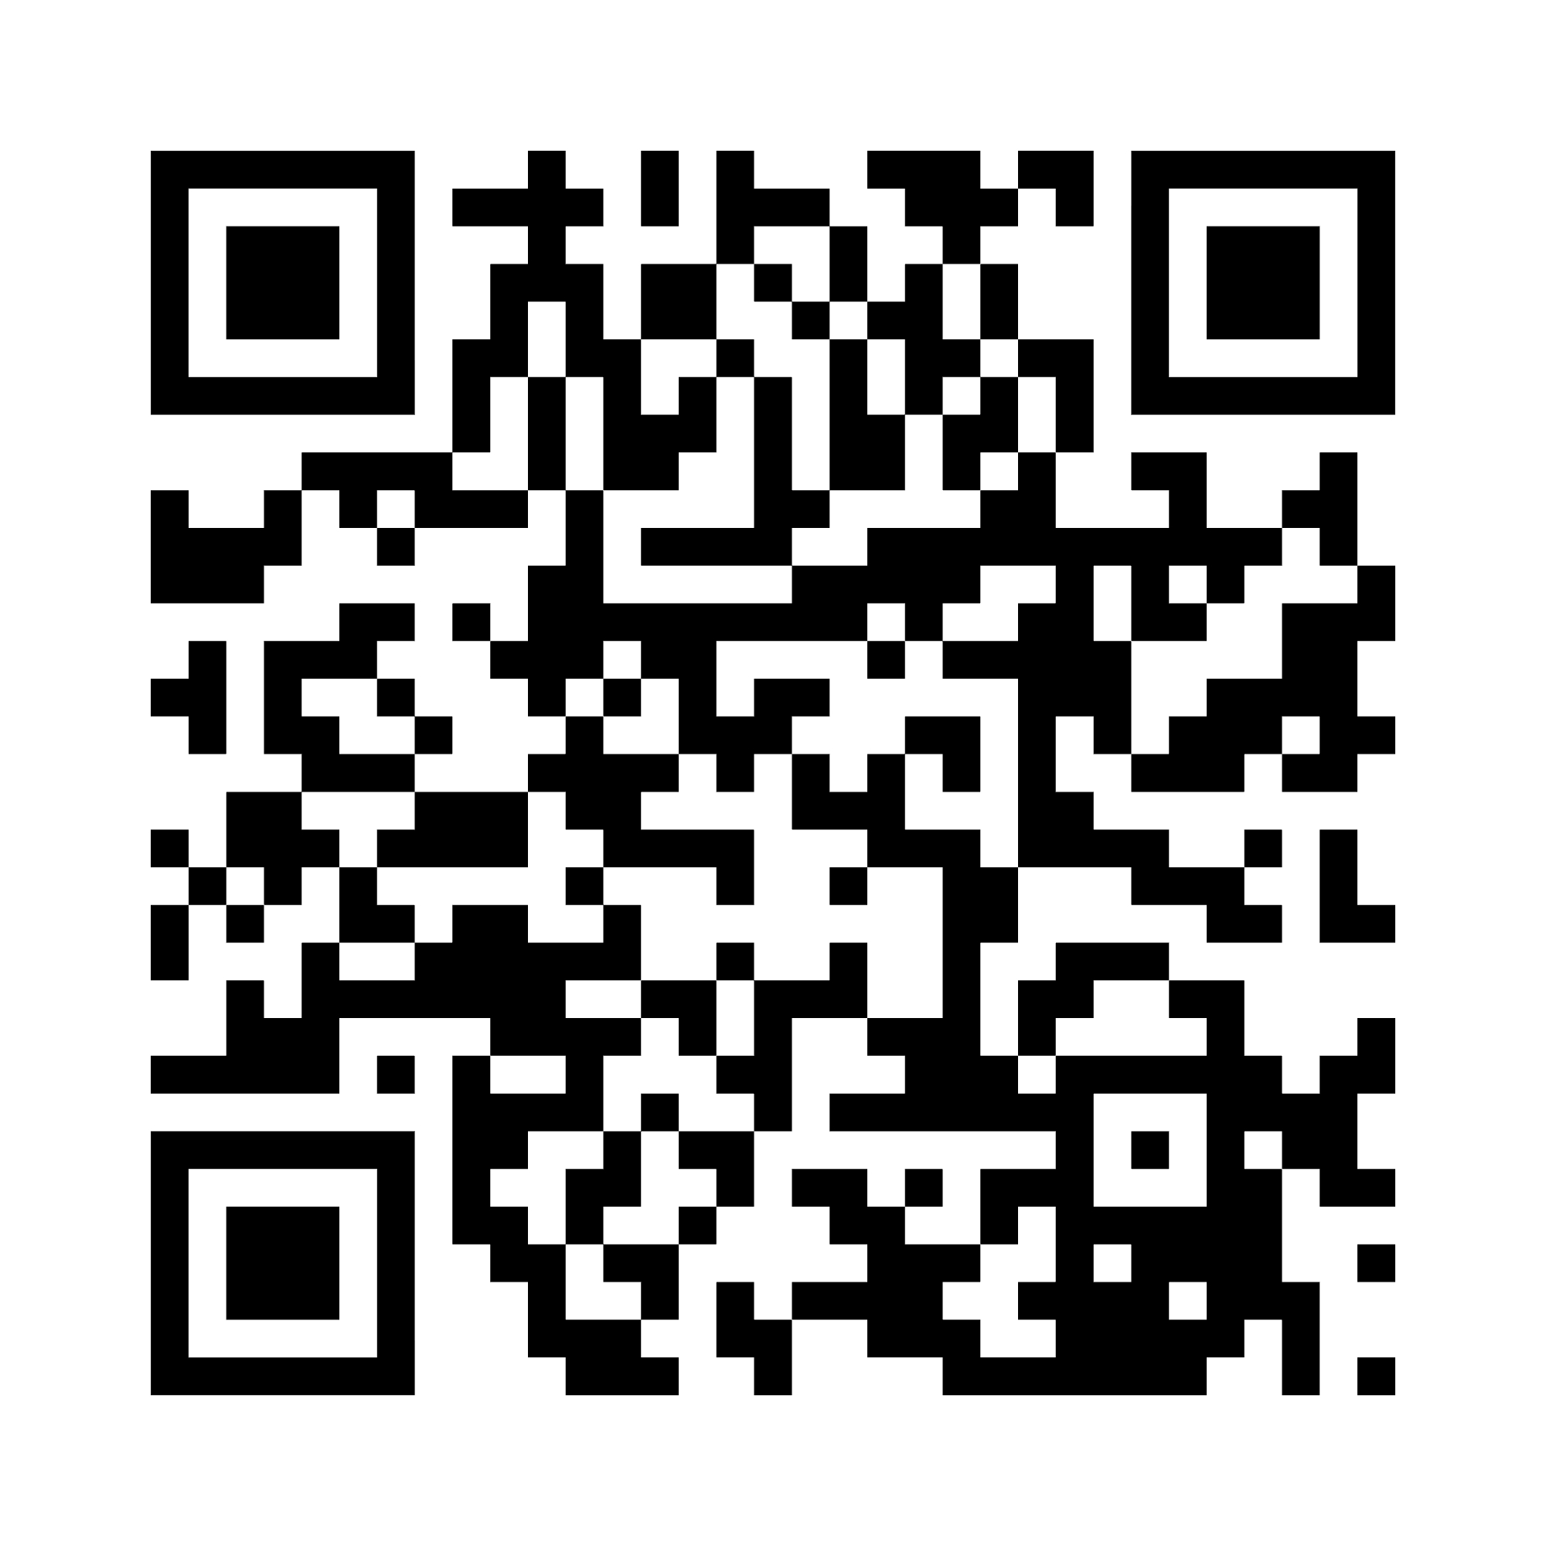
THANK YOU!
Questions? Comments? Email RMC@NICHQ.ORG.
LINK TO DOWNLOAD RESOURCES

